Slide 1
Marina DuNES Tax INCREMENT Bonds consolidated oVERSIGHT BOARD for Monterey county
March 23, 2022
goldfarb & lipman llp

Slide 2
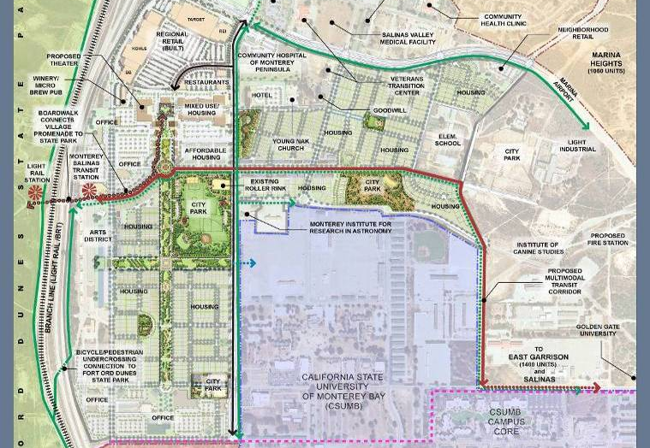
Marina Successor Agency
The Dunes at Monterey Bay

Slide 3
The Dunes
Development Program
  Removal of approximately 940 abandoned military structures
  Retail – 500,000 square feet of regional, village promenade and neighborhood retail
  Office and medical totaling approximately 600,000 square feet
  Beach Boardwalk – to connect the development project to Fort Ord Dunes State Park
  Residential – 1,237 Residential Units with 310 below market rate affordable units (25% affordable)
  Linear Park – 47 acres of Parks (including City Park on PBC)
  Future Transit Corridor
  Hotel – Up to 500 Rooms

Slide 4
The Dunes Development to Date
Removal of 390 blighted structures, 1.4 million square feet
Completion of 430,000 sf of retail center and cinema
VA Medical Center and Montage Wellness Center
Completion of 106-room hotel
Completion of 108 affordable housing units
Completion of 342 market rate and workforce homes
125 market rate homes under construction

Slide 5
Disposition and Development Agreement
Disposition and Development Agreement entered into in 2005 with former Redevelopment Agency
First Implementation Agreement – September 2006
Second Implementation Agreement –August 2008
Operating Agreement including conforming clarifications to schedule of performance – December 2019

Slide 6
Second Implementation Agreement
Tax Increment Pledge
  Former RDA pledged 100% of Available Non-housing Tax Increment Funds from the Project (all tax increment after 20% LMIHF deposit, pass throughs to taxing entities, less 10%) to pay for infrastructure costs through fiscal year 2036-2037
  Former Agency pledged Available LMIHF Tax Increment generated by the Dunes Project as well as the Marina Heights Project (now Sea Haven) to pay for affordable housing costs through fiscal year 2026-2027
  Parties entered into Tax Increment Financing Plan and Agreement

Slide 7
Second Implementation Agreement
Department of Finance has recognized pledge of tax increment as an enforceable obligation on all Successor Agency ROPS

Slide 8
Tax Increment Financing Plan and Agreement
Bond Requirements
  Developer may request the Agency to issue bonds secured solely by a pledge of the Available Non-Housing Tax Increment Funds and Available LMIHF Tax Increment
  Agency to act reasonably and in good faith to issue bonds
  Term of the bonds shall be no less than 20 years regardless of the term of the pledge
  Bonds to have a debt service coverage ratio of no less than 115% and no more than 125%

Slide 9
Bond issuance Process – Post Dissolution
Redevelopment Dissolution Act (AB 1x26 as amended by AB 1484 and SB 107) governs the process for issuance of bonds by Successor Agency
Dissolution Act allows for the issuance of tax increment bonds to make payments under enforceable obligations when the enforceable obligations include the irrevocable pledge of property tax increment and the obligation to issue bonds secured by the pledge (Health and Safety Code Section 34177.5(a)(2))

Slide 10
Bond Issuance Process
Dissolution Act requires that the issuance of the bonds be approved by
  The Successor Agency Board (the Marina City Council acting as the governing board of the Successor Agency)
  The Oversight Board
  The Department of Finance. Department of Finance has 65 days to approve of issuance after Oversight Board approval.

Slide 11
2018 Bonds
Successor Agency, Oversight Board and DOF approved issuance of bonds in 2017/2018
Successor Agency issued bonds in June 2018 in the total amount of $13,490,000
Bond proceeds were disbursed to Developer to reimburse Developer for eligible costs

Slide 12
2020 Bonds
Successor Agency, Oversight Board and DOF approved issuance of bonds in 2020
Successor Agency issued bonds total amount of $9,740,000
Bond proceeds were disbursed to Developer for infrastructure and affordable housing costs previously incurred.

Slide 13
2022 Bonds
Successor Agency authorized issuance of Bonds on March 1, 2022 –Resolution No: 2022-01
Authorization is requested to issue bonds up to $17,000,000
Bond proceeds will reimburse Developer for infrastructure and affordable housing costs.

Slide 14
Next Steps
Oversight Board considers resolution approving issuance of bonds
Oversight Board resolution submitted to Department of Finance for review and approval
Department of Finance approval received
Bonds issued

