Slide 1


Harper Canyon (Encina Hills) Subdivision Supplemental
Environmental Impact Report
Public Scoping Meeting
July 25, 2022
County of Monterey – Housing and Community Development
and
Denise Duffy & Associates, Inc.
Notes:
Welcome,
Housekeeping:
Present and then Q&A
Recorded to document comments and make available to the public who can’t attend
Encourage written comments as well
Spanish- Alguien necesita ayuda para traducir al espanol?

Slide 2
Meeting Overview
Introductions
Proposed Project Overview
Environmental Review Process
Purpose of Scoping Meeting
Receive Public Comments
Notes:
Introduce you to project team here today
Provide an overview of the proposed project and env. review process
Discuss the purpose of a scoping meeting
Invite you to talk to staff, ask questions, provide oral comments

Slide 3
Introductions
Notes:
Point out project team members here tonight
Erik Lundquist – Director of Housing and Community Development, Monterey County
Erin Harwayne – Senior Planner, Denise Duffy & Associates
[Insert additional staff present]
DD&A is contracted by the County of Monterey to prepare environmental documentation for the proposed project. The County of Monterey is lead agency under CEQA and managing the environmental review process for Harper Canyon Subdivision Supplemental EIR.

Slide 4
Project Overview: Project Background
Application for proposed project completed in November 2002
Draft EIR distributed in October 2008
Recirculated Draft EIR was prepared in 2009
Final EIR was prepared in 2013
Notes:
Project has a long history going back to 2002…

Slide 5
Project Overview: Project Background
EIR was certified and approved in April 2015
Condition Compliance and Mitigation Monitoring and Reporting Plan was developed
2015 Court of Appeal, Landwatch Monterey et al. v. County of Monterey et al., Case No. H046932
Notes:
The 2015 Board of Supervisor's decision was challenged and ultimately resulted in the Sixth District Court of Appeal’s opinion that the EIR lacked analysis concerning the proposed project’s potential impacts to the Toro Creek wildlife corridor (Landwatch Monterey et al. v. County of Monterey et al., Case No. H046932). As a response to the court of appeal ruling, a supplemental draft EIR was requested to evaluate the proposed project’s potential impacts on the wildlife corridors in the vicinity of the proposed project site.

Slide 6
Project Overview: Project Description
Harper Canyon Subdivision is a 17-lot subdivision
Located on 164 acres, with one 180-acre remainder parcel

Slide 7
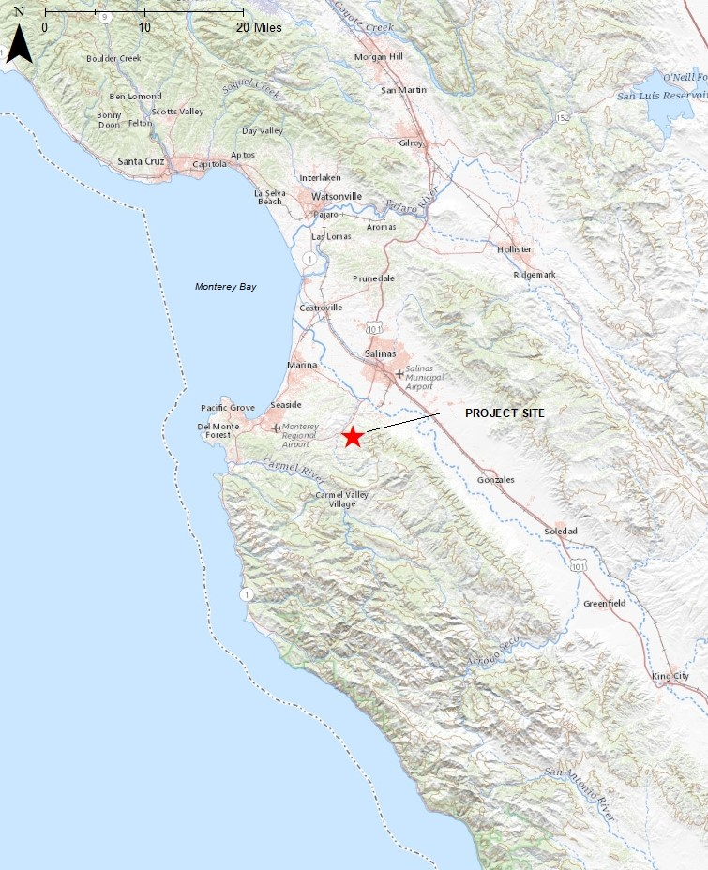
Project Vicinity
Notes:
proposed project is located along the State Route 68 corridor of Monterey County off San Benancio Road

Slide 8
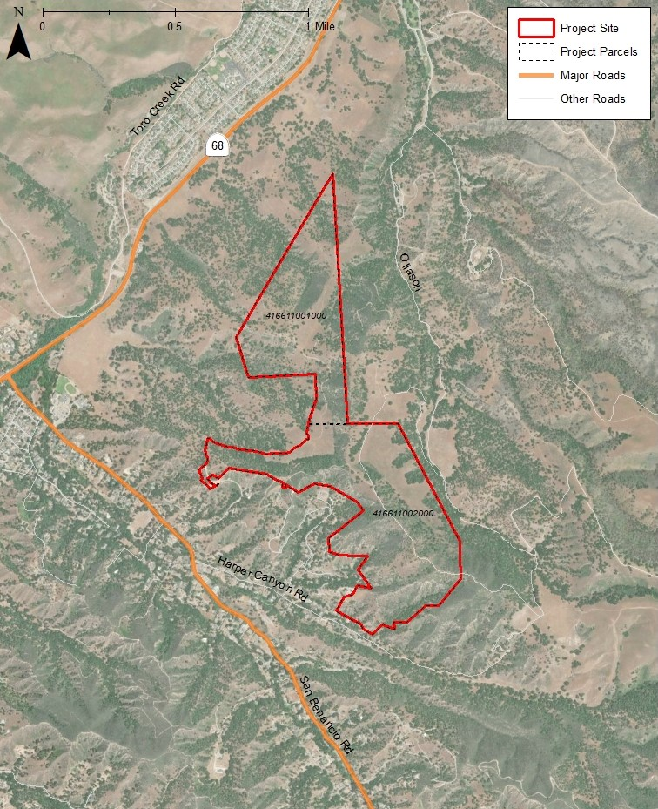
Proposed Project
Site
Notes:
17-lot subdivision on 164 acres, with one 180-acre remainder parcel

Slide 9
Environmental Process: Purpose & Requirements of CEQA
Inform decision-making
Identify ways to avoid or reduce environmental damage
Prevent significant damage to environment
Public disclosure
Public participation
Notes:
Monterey County is the Lead Agency
Purpose: CEQA Guidelines §15002(a)
Inform decision-makers and public about potential significant environmental effects of a proposed project
Identify ways that environmental damage can be avoided or significantly reduced
Prevent significant avoidable damage to environment by requiring changes in projects through the use of alternatives or mitigation measures when the agency finds the changes to be feasible
Disclose to the public the reasons the agency approved the project
Facilitate and support public participation

Slide 10
Environmental Process: Purpose of Supplemental EIR
Examine wildlife movement between Fort Ord National Monument, Santa Lucia Ranges, and Toro Creek via under-crossings of State Route 68, overpasses along Portola Drive, and local/onsite drainages and culverts.
Focus solely on analyzing wildlife corridors in the vicinity of the proposed project.
Notes:
In accordance with the court decision…the primary purpose of the SEIR is to focus solely on analyzing wildlife corridors in the vicinity of the project site
Disclose and evaluate the potentially significant environmental impacts related to wildlife corridors and movement
Identify mitigation measures to lessen or avoid impacts, if necessary

Slide 11
SEIR Process
NOTICE OF PREPARATION/
SCOPING PERIOD
30-DAY SCOPING PERIOD
July 15 – Aug. 15, 2022
We are here
DRAFT Supplemental EIR
45-DAY PUBLIC REVIEW PERIOD
November 2022
Final Supplemental EIR
REVIEW OF FINAL SEIR
February 2023
PUBLIC HEARING
Decision on the
Project/CEQA Findings
April 2023
Notes:
Overview of process which highlights opportunities for public participation
SEIR follows EIR process per CEQA Guidelines
NOP issued 07/15 initiating the 30-day scoping period
Early public input in the environmental process
1st step in the environmental review process
Review comments
Prepare and distribute Draft SEIR
45-day public review period, submit comments, we will have a public meeting
Respond to comments, revise Draft SEIR-finalize SEIR and make available to public prior to public hearing

Slide 12
Notice of Preparation & Scoping: Purpose of Today’s Meeting
30-day public comment period on NOP
Solicit comments on the scope of the SEIR analysis on wildlife corridors (focused analysis)
Comments should identify:
    Environmental issues or concerns
    Reasonable alternatives & mitigation measures
Notes:
Purpose: CEQA Guidelines §15082(a)
“Scoping” is gathering information on the context and focus of the environmental analysis

Slide 13
Comments on Scope of EIR
Comments Due: August 15, 2022, 5 PM
    Ways to provide comment:
    Provide verbal comment today
    ALSO, provide written comment by deadline above
    email comments to: CEQAcomments@co.Monterey.ca.us
    mail in your comment to:
ATTN: Erik Lundquist, AICP
Directory of Housing & Community Development
Monterey County HCD
2441 Schilling Place
Salinas, CA 93901

Slide 14
For More Information & Stay Informed
County’s Website & Project Site
Harper Canyon (Encina Hills) Subdivision EIR | Monterey County, CA
Notes:
Contact Erik and also visit website

Slide 15
Public Comments
Thank you for your interest and participation!
Notes:
Open for public comments

