Slide 1

2023 Legislative Workshop
Monterey County
Board of Supervisors
January 20, 2023

Slide 2
Legislative Proposal
Monterey County
Veterans Home
The County will sponsor State legislation that permits the construction of a Veterans Home in Monterey County – preferably on or near the former Fort Ord.
The scope of the project, location and cost are to be determined in coordination with the California Department of Veterans Affairs (CalVet) and U.S. Department of Veterans Affairs (VA).
Proposal seeks to authorize legislation similar to SB 1234 (Johannessen) in 2002 that would authorize the State Public Works Board to issue lease-revenue bonds to finance acquisition, design, and construction of an additional Veterans Home in Monterey County, and to allow the State Department of General Services, on behalf of CalVet, to construct an additional Veterans Home. The legislation should also seek a continuous appropriation for its operation.
Federal legislative efforts are also needed to secure two-thirds of the costs for the acquisition, design and construction and a continuous appropriation for its operation through the U.S. Department of Veterans Affairs (VA).

Slide 3
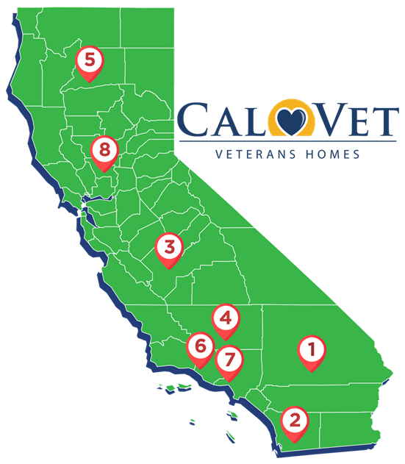
CalVet Veterans Homes
CalVet has eight (8) Veterans Homes that offer affordable long-term care to Veterans who are age 55+, eligible spouses and domestic partners are eligible to apply for admission.
The age requirement is waived for disabled or homeless veterans needing long-term care.
Services range from independent living programs with minimal support to 24/7 skilled nursing and dementia care for veterans with significant clinical needs.
Four (4) of the Veterans Homes offer skilled nursing and dementia care, all of which have 2 to 5+ year waiting lists.
All the Veterans Homes are at a considerable distance from Monterey County with the closest in Fresno and Yountville (both 2.5 hours away) and Ventura (4 hours away).

Slide 4
California Veterans
Largest Veteran population in U.S. - over 1.6 million
  21,000 in Monterey County plus thousands of active and reserve military members
  57,000 in Santa Clara County
  10,000 in Santa Cruz County
  17,800 in San Luis Obispo County
  2,500 in San Benito County
  108,000 collectively
Accessing VA Compensation and Pension (C&P) Benefits at greater levels than ever before.
    15.8% in 2011 v. 27.8% in 2019
    Total - over $8 billion in FY 2019

Slide 5
Homeless Funding Formulas
State and Federal partners need to identify a different means to assess community needs when allocating funds to address homelessness.
Homeless funding formulas inadvertently penalize communities for reducing homelessness.
The Point-in-Time (PIT) Count is a federally mandated snapshot of people experiencing homelessness which is used to determine state and federal funding allocations.
The 2017 PIT revealed that on any given night 2,837 individuals were experiencing homelessness in Monterey County, the highest count in our history. In response, stakeholders moved swiftly to overhaul the homelessness response system – bringing in funding from Supportive Services for Veteran Families (SSVF), the Youth Homeless Demonstration Program (YHDP), updating the regional plan to end homelessness, and opening several new navigation centers, transitional housing, and permanent supportive housing programs.
In 2022, Monterey County experienced a significant decrease in the PIT, having counted 2,047 individuals on the night of the count, the lowest count in our history. While we celebrate the accomplishment of working towards our overarching goal, this 28% decrease is expected to have severe impacts on upcoming State funding (i.e., Round 4 - Homeless Housing Assistance and Prevention (HHAP), and others).

Slide 6
Homeless Funding Formulas
Point-in-Time counts are both far too low and too unreliable to be used as a sole basis for understanding a region’s homelessness service needs.
PIT counts don’t exhibit the true need to properly address homelessness. In Monterey County, the Homeless Management Information System (HMIS) shows more than double the PIT are accessing services throughout the year.
Inconsistent methodologies, access to volunteers, and the unique characteristics of communities can also lead to irregularities in funding allocations.
PIT counts are designed to only capture information on people visibly experiencing homelessness as described in Category 1 of HUD’s definition of homelessness. People experiencing homelessness in Categories 2-4 aren’t included in the count, however access services throughout the year.
Other factors should be considered in determining allocations like cost of living, housing stock, area median income, fair market rate, and long-term stabilization of programs in communities that are successfully reducing homelessness.

Slide 7
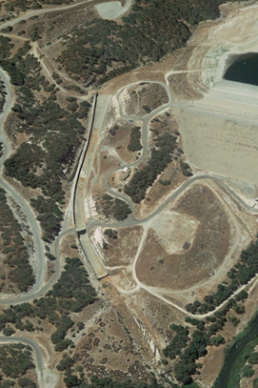
Nacimiento & San Antonio Dam Safety
High Priority Capital Asset Management
Provides flood control, drought resiliency, water supply, groundwater recharge, recreation, and other benefits
  More than 418,000 acres supporting County’s $11.7 billion agricultural industry
  Over 200,000 residents utilizing groundwater as the primary drinking water supply
  Reservoir operations provide a buffer against drought conditions to Salinas Valley water users
Fully operational facilities are critical for implementation of Groundwater Sustainability Plans
  MCWRA currently has self-imposed risk reduction measures in place reducing water storage and release amounts
  Without these projects these operational restrictions could become mandatory
State support to date includes:
  $6.1 million for Nacimiento Dam Maintenance Projects
Estimated Cost - $160 million:
  $60M – San Antonio Spillway Repair/Replacement (DSOD deadline November 2024)
  $20M – Nacimiento Spillway Plunge Pool Erosion Control
  $24M – Nacimiento Spillway Rehabilitation
  $56M – Low Level Outlets repairs, drain repairs, seismic stability, boil prevention, etc

Slide 8
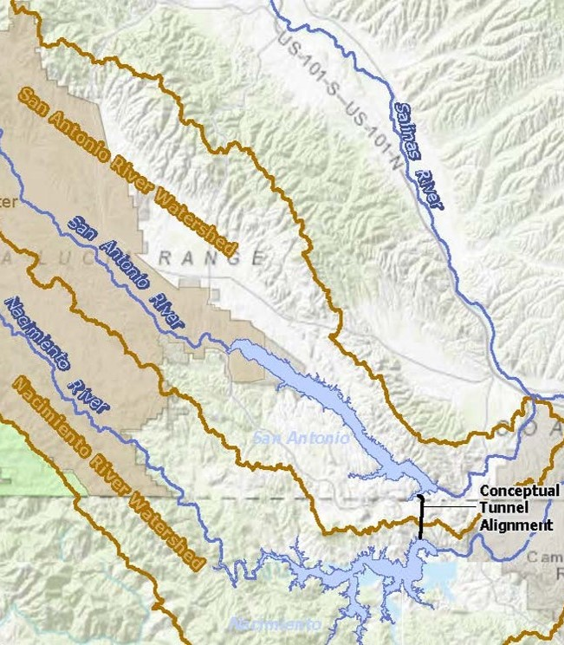
Interlake Tunnel and San Antonio Spillway Modification Project
  Underground tunnel to move water from Nacimiento to San Antonio
  Reduces flood control releases from Nacimiento
  Utilizes water storage space available in San Antonio
  Spillway raise increase water storage space available in San Antonio
State support for Project to date includes:
  $10 million for project planning and design
  $17 million for Fish Exclusion System to prevent fish movement
  Estimated cost: $180 million

Slide 9
San Lucas Clean Drinking Water Project
Construct a new pipeline to tie into the Cal Water system in King City to provide a clean, long-term, reliable sources of drinking water to meet the community’s current and future needs.
Estimated cost $15 million
San Lucas is a small, severely disadvantaged farming community. The community water system (approximately 100 connections) is owned and operated by the San Lucas County Water District (District). The project would address ongoing water quality problems at the existing District water source which have occurred since 2006. The project would construct a new pipeline to tie into the Cal Water system in King City and deliver water directly to the District water distribution tank. The pipeline is anticipated to be 7.8 miles long. Funding in the amount of $15 million is sought for design, environmental assessment, engineering, and construction work.

Slide 10
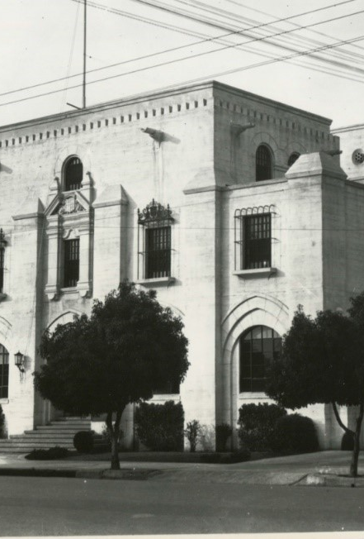
Old Monterey County Jail
Constructed in 1931 in the Gothic Revival style, which was often used during the Art Deco Period of the 19th century for public buildings and academic structures.
In 1970, Cesar Chavez, co-founder of the United Farm Workers, was held in the jail for 20 days for refusing to call off a lettuce boycott, thereby raising national and international attention for farmworkers. His incarceration brought national figures such as Ethel Kennedy and Coretta Scott King to the jail to visit and advocate for his release. This event is considered pivotal in the struggle for farm labor rights.
In 2004, the Jail was listed on the U.S. National Register of Historic Places reflecting its architectural significance and for areas where Cesar Chavez was imprisoned. It is the only historic landmark of the farmworker rights movement on the Central Coast.
This project presents a unique opportunity to preserve and reuse the historic site, stimulate local economy, promote cultural pride for a significant event in the farm labor movement, with careful consideration of the community’s needs and with respect for the historic significance of the site.
Estimated cost - $17.25 million

Slide 11
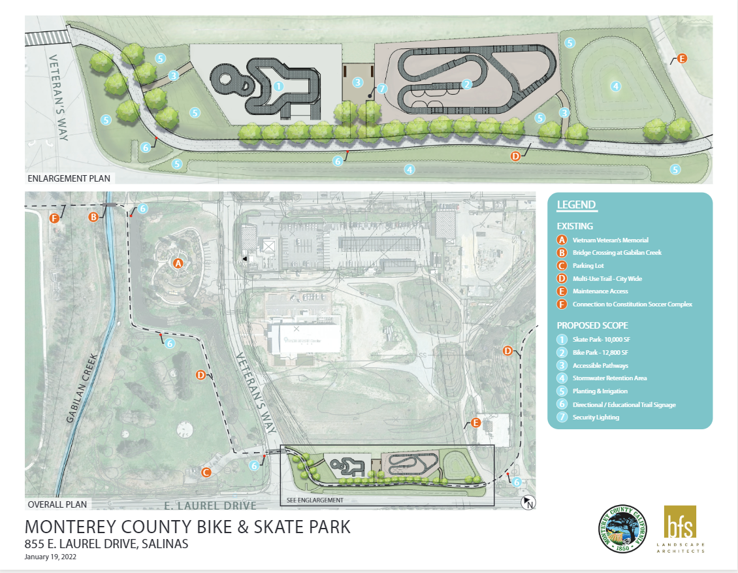
Bike and Skate Park
855 East Laurel Drive, Salinas
  Construct a regional Bike and Skate Park serving Monterey, San Benito, and Santa Cruz Counties.
  The proposed site is linked by several multi-use trails connecting the project to some of the most underserved neighborhoods and several elementary schools and will complement the adjacent existing recreation features.
  The property is easily accessible from U.S. Interstate 101, nested within the County’s most densely populated area and contiguous to recreation features: Salinas Regional Soccer Complex, Monterey County Vietnam Veterans Memorial Park, Carr Lake, Natividad Creek Park, and the Twin Creeks Golf Course/First Tee Monterey County.
  The Bike Park (approximately 12,800 square feet) will include various terrain and riding conditions that will allow riders to progress their skills (beginner to advanced) and safely practice their sport.
  The Skate Park (approximately 9,470 square feet) will include quarter pipes, half pipes, and bowls along with street skating features including stairs, rails, curbs, ramps, and ledges.
  Important partners for this project include the City of Salinas, the Salinas Regional Soccer Complex, and the Monterey County Blue Zones Project.

Slide 12
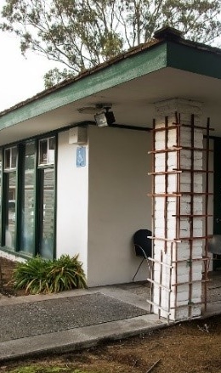
Monterey County Clinic in Marina
The current Marina Clinic is 1,790 square feet, with 4-exam rooms, and is staffed by two (2) physicians that offer general family practice services. The building has a poor layout and is too small to serve the needs of the community.
The proposal is to construct a new 14,000 sq. ft. primary care clinic with expanded general family practice, pediatric, obstetrics and gynecology, mental health services for Medi-Cal and uninsured residents and dental services for underserved/unserved veteran residents.
The Marina Clinic is designated as a Medically Underserved Area (MUA), Dental and Mental Health – Health Professional Shortage Area (HPSA).
Estimated project cost - $14 million.

Slide 13
Immigration Reform – and –
Farm Bill Reauthorization
  Agriculture in Monterey County supports over 64,000 jobs and injects nearly $12 billion into our local economy
  Current immigration policies make it difficult to meet the workforce needs of our local agricultural industry
  The Farm Workforce Modernization Act would benefit workers and employers while allowing certain farmworkers to earn legal status through continued agricultural employment
  Reauthorization of the Farm Bill is critical for our local agricultural industry, consumers, and the natural environment

Slide 14
FEMA Disaster Assistance Cost Recovery
Improve FEMA Public Assistance Program, expedite grant award processing, streamline disaster debris removal programs.
  The County is working with CalOES and FEMA to recover emergency costs related to the COVID-19 Public Health Emergency, 2020 Wildfires, and 2021 Winter Storms. Millions in FEMA Public Assistance grant requests have been submitted. Lengthy FEMA review time, at times taking 2-years to recover approved and expended costs for disaster response and recovery efforts.
  Concern that FEMA may reduce or change how disaster events qualify for reimbursement funding. The County is recovering from multiple disaster events and working to increase staff capacity to meet the time consuming, complex, and cumbersome process of ensuring documentation and projects are submitted to CalOES and FEMA in an efficient and effective manner.
  The County participated in the CalOES/CalRecycle Government Sponsored Private Property Debris Removal Program after the 2020 Wildfires. Debris removal complete in August 2021. The County has not received a MOU from CalOES outlining County responsibilities to collect insurance monies from participating property owners; and has not received invoices or receipts per parcel. Until such time, the County cannot move forward with ensuring there have not been a duplication of benefits.
  The County recommends that CalOES and FEMA evaluate policies in the FEMA Public Assistance Program and Policy Guide to address Private Property Debris Removal Program eligibility for structures with multiple standing walls, communities with gates, and communities with homeowner associations to make them more equitable, efficient, and streamlined.
  After the 2020 Wildfires, the River Fire Burn Scar has created regular debris, mud, and flood flows for residents downslope. The most notable event was the 2021 Winter Storms, in which 25 residential properties were damaged or destroyed. Due to the scale of the damage, residents have been unable to access any disaster relief services. Most notably is the complex challenges surrounding mud and flood flows from County, State, and Federal wildland into residential areas, impacting private roads. Some of these private residential roads impacted are not owned by any one person or group of individuals and therefore the cost and responsibility of mud and debris removal on these roads is unknown.

