Slide 1
HIV Planning Group
April 28, 2023
Brandon Gates, Public Health Program Manager
Diksha Ramnani, Supervising Public Health Epidemiologist

Slide 2
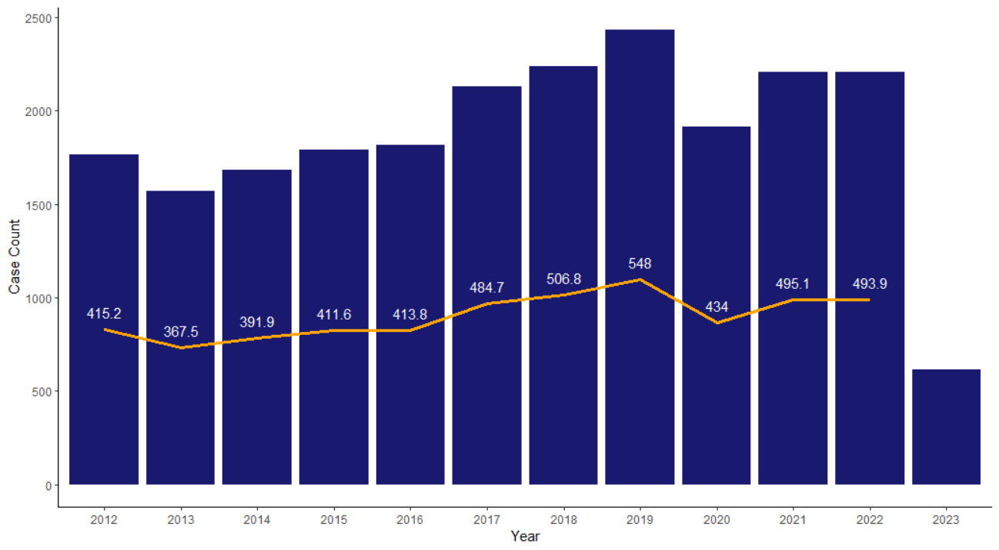
Chlamydia – Overall Trends
Year | Case Count
2012 | 1764
2013 | 1569
2014 | 1683
2015 | 1789
2016 | 1815
2017 | 2132
2018 | 2239
2019 | 2430
2020 | 1915
2021 | 2203
2022 | 2208
2023 | 567

Slide 3
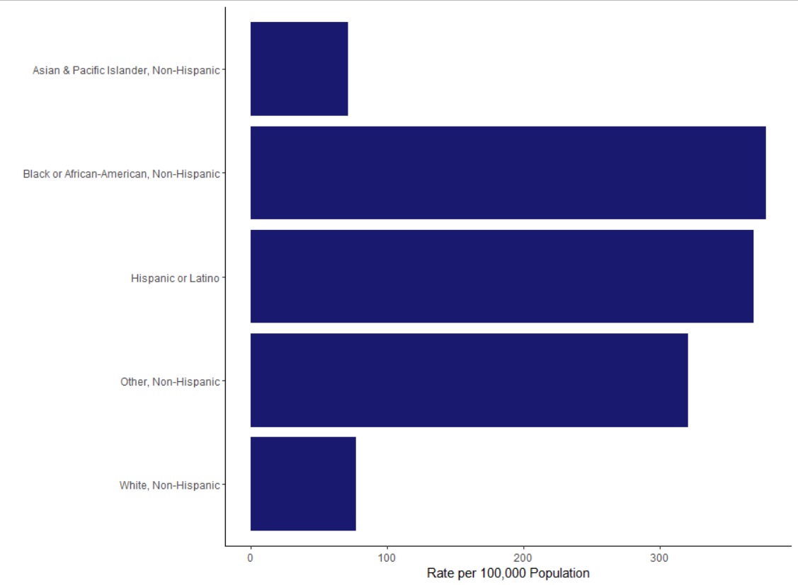
Chlamydia – Demographic Data (2019-2021)

Slide 4
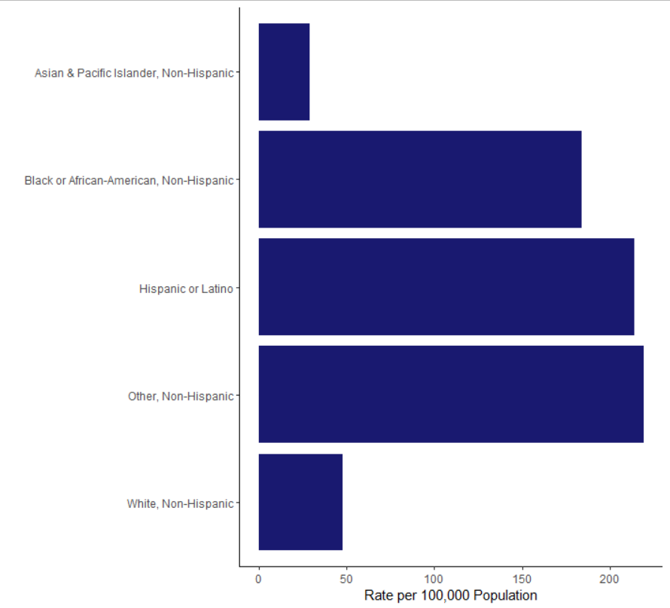
Chlamydia – Preliminary Demographic Data (2022-Present)

Slide 5
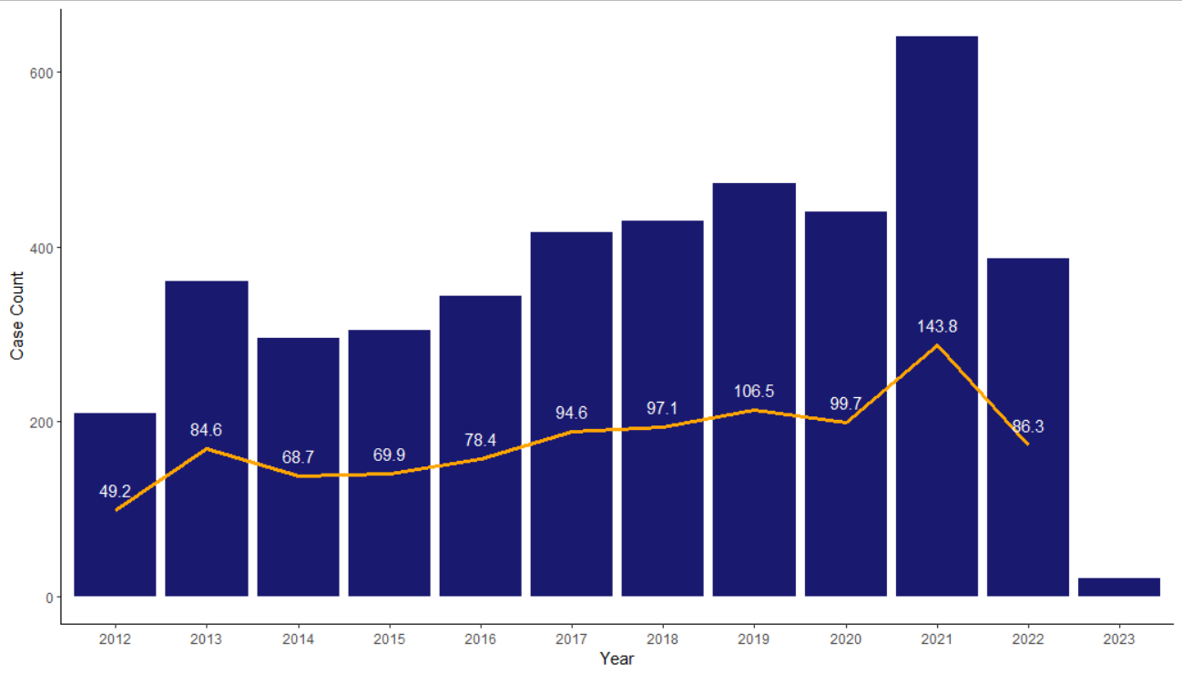
Gonorrhea – Overall Trends
Year | Case Count
2012 | 209
2013 | 361
2014 | 295
2015 | 304
2016 | 344
2017 | 416
2018 | 429
2019 | 472
2020 | 440
2021 | 640
2022 | 386
2023 | 20

Slide 6
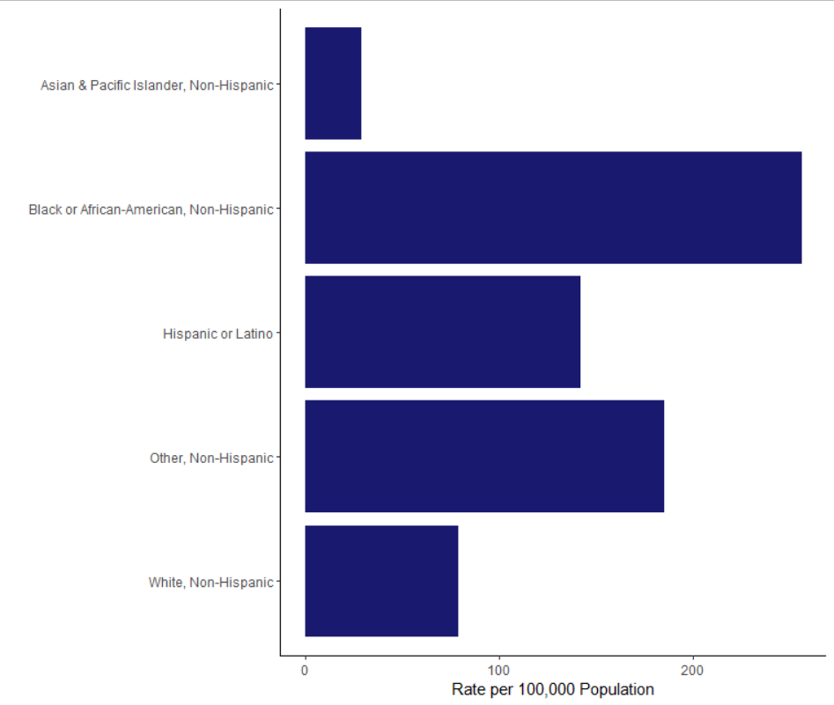
Gonorrhea – Demographic Data (2019-2021)

Slide 7
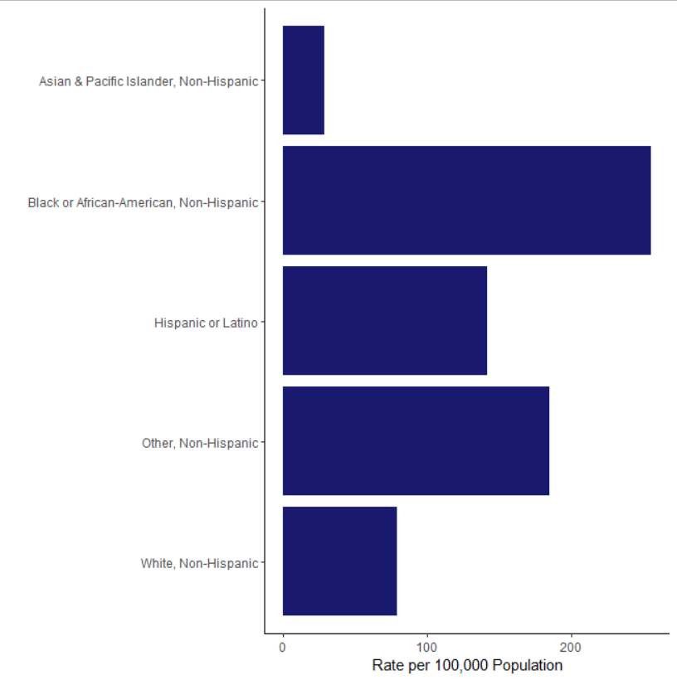
Gonorrhea – Preliminary Demographic Data (2022-Present)

Slide 8
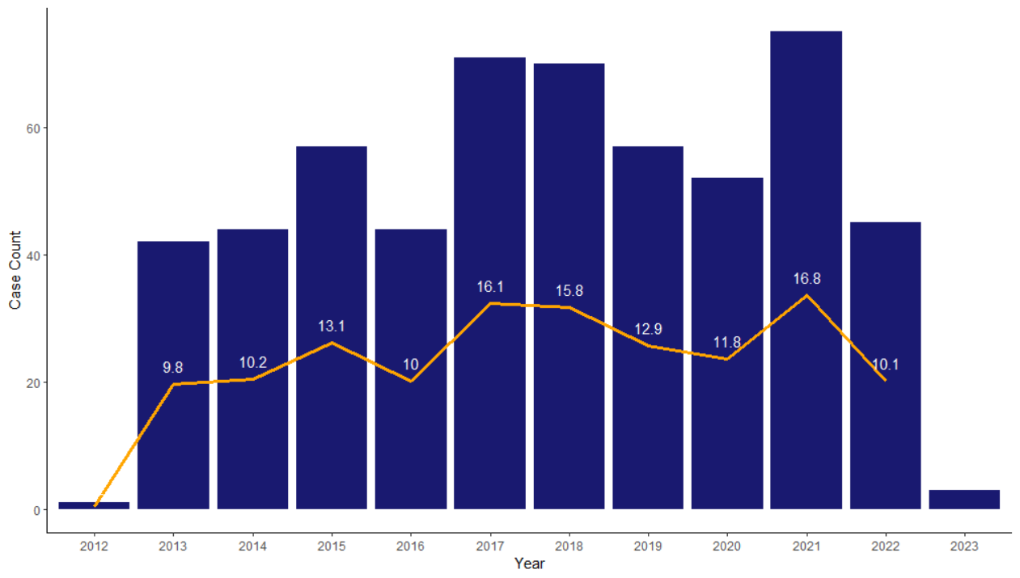
Early Stage Syphilis
Year | Case Count
2012 | 1
2013 | 42
2014 | 44
2015 | 57
2016 | 44
2017 | 71
2018 | 70
2019 | 57
2020 | 52
2021 | 75
2022 | 45
2023 | 3

Slide 9
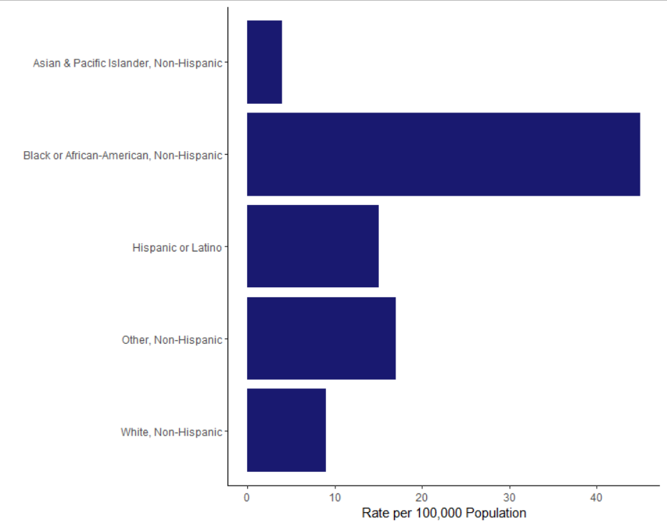
Syphilis – Demographic Data (2019-2021)

Slide 10
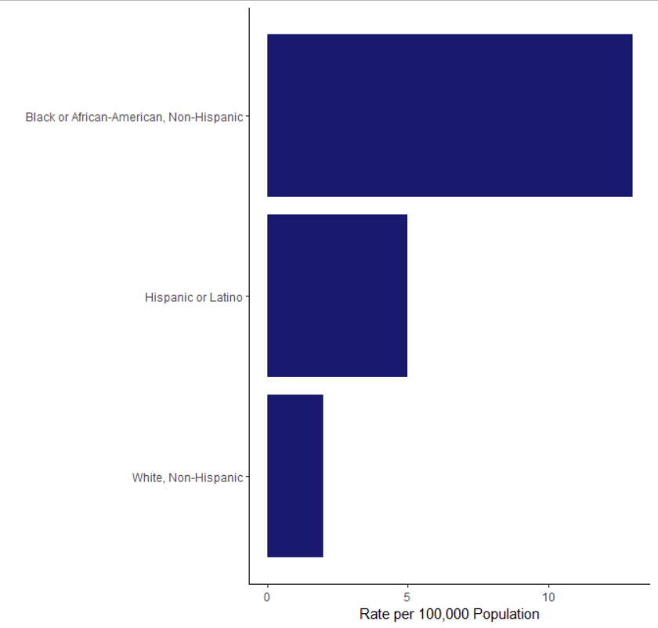
Syphilis – Preliminary Demographic Data (2022-Present)

Slide 11
Monkeypox (MPOX) - California
Reference: https://www.cdph.ca.gov/Programs/CID/DCDC/Pages/Mpox-Data.aspx

Slide 12
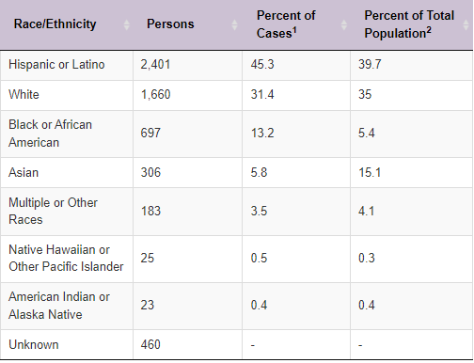
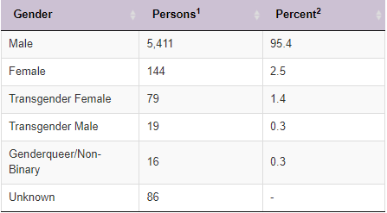
Monkeypox (MPOX) - California
Reference: https://www.cdph.ca.gov/Programs/CID/DCDC/Pages/Mpox-Data.aspx

Slide 13
MPOX – Monterey County

Slide 14
MPOX - Vaccination
916 doses of Jynneos administered in Monterey County

Slide 15
HIV – Overall Trends
*2022 data are provisional

Slide 16
HIV – Demographic Data (2018 – 2020)

Slide 17
HIV – Demographic Data (2018 – 2020)

Slide 18
HIV – Demographic Data (2018 – 2020)
*will not sum to 100% because individuals could report multiple risk behaviors.

Slide 19
For Questions:
Epidemiology & Surveillance Unit
MCHDEpi@co.monterey.ca.us
831-755-4698
Thank you!

