Slide 1
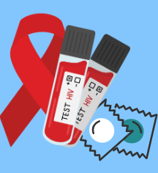
A Quantitative Study on Increasing HIV/AIDS Awareness Among the Latinx Population in Monterey County by Implementing an HIV/AIDS Awareness and Action Seminar
A Project Presented in Partial Fulfillment of the Requirements for the Degree of Master of Public Health
By: Ruby Ramos Godoy
College of Health and Human Services/Department of Public Health

Slide 2
Purpose of the Study
Research Questions
Research Method and Design
Outline
Study Results
Discussion
Implications and Future Recommendations
Questions
College of Health and Human Services/Department of Public Health

Slide 3
Purpose of the Study
The HIV/AIDS Awareness and Action Seminar strived to increase awareness of HIV/AIDS by educating participants about transmission, risk reduction, and linkage to care in Monterey County. Aiming to educate community members about HIV/AIDS will help reduce the county's new diagnoses of HIV/AIDS and reduce barriers to safer sex supplies and HIV tests.
College of Health and Human Services/Department of Public Health

Slide 4
Research Questions
Research Question 1
Do HIV/AIDS Awareness and Action Seminars improve Latinx HIV knowledge?
Research Question 2
Did the seminar increase awareness of HIV/AIDS resources in Monterey County among participants?
College of Health and Human Services/Department of Public Health

Slide 5
Research Methods and Design
Quantitative Study
Primary Data Collection
Implementation of a HIV/AIDS Awareness & Action Seminar through the Monterey County Health Department in Salinas, CA
24 participants
Pre & Post tests Completed
Eligibility Criteria
Signed Consent Forms
Monterey County Resident
College of Health and Human Services/Department of Public Health

Slide 6
Research Methods and Design
Participant Recruitment
Social Media Posts
Partners
Flyers posted
Survey and Consent Form
Consent forms were signed at the door prior to entering & receiving Pre/Post test
Surveys were provided in English and Spanish in paper form
Each pre/post test had a number to match the tests
Pre-test was collected at the beginning
Post-test was collected at the end
College of Health and Human Services/Department of Public Health

Slide 7
Research Methods and Design
HIV/AIDS Awareness and Action Seminar
1 day event (2 hours)
Monterey County HIV Data Update
Simultaneous Presentations (HIV 101 & HIV Care in Monterey County)
HIV Testing Overview Presentation
HIV Testing Onsite
Rapid Testing
At-home Testing Kits
Free Safer Sex Supplies
Internal and External Condoms, lubricant, and informational brochures
Analyzed through SPSS
Cronbach’s Alpha
Paired Sample T-Test
Descriptive Statistics
College of Health and Human Services/Department of Public Health

Slide 8
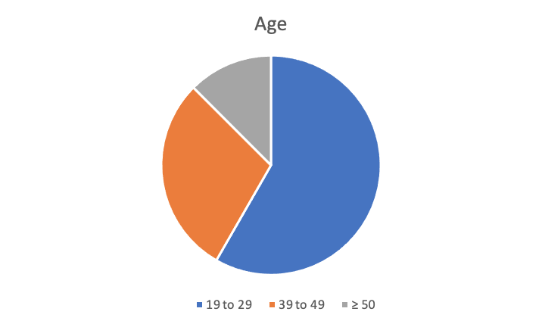
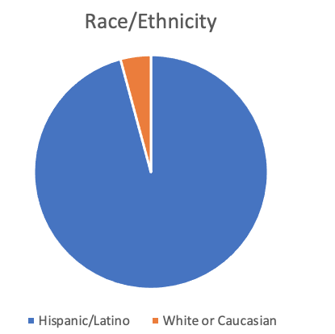
Demographics
College of Health and Human Services/Department of Public Health

Slide 9
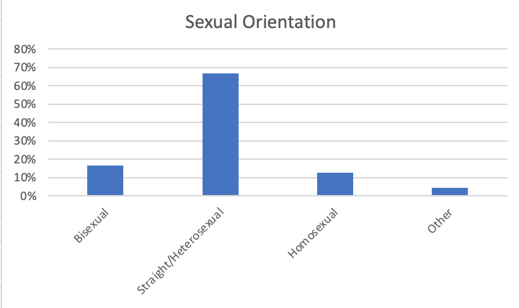
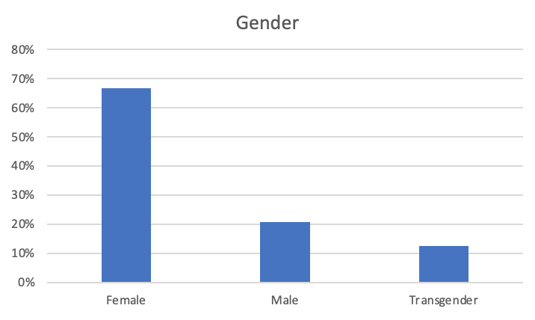
Demographics
College of Health and Human Services/Department of Public Health

Slide 10
Results - Paired Sample T-Test
College of Health and Human Services/Department of Public Health

Slide 11
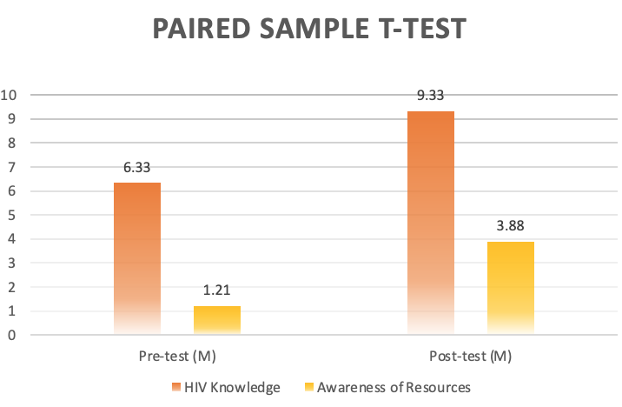
College of Health and Human Services/Department of Public Health

Slide 12
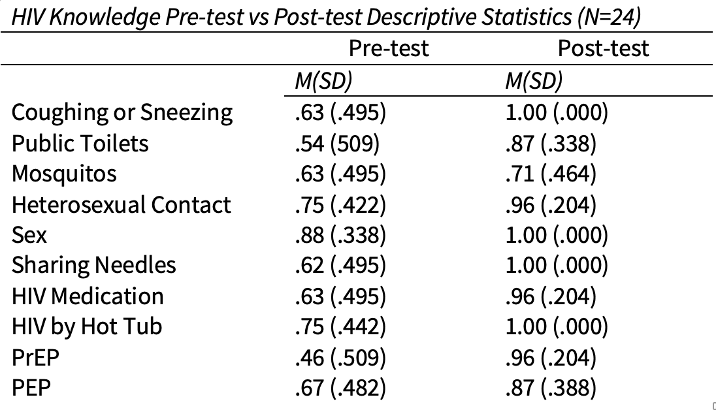
Results - Descriptive Statistics
College of Health and Human Services/Department of Public Health

Slide 13
Results - Descriptive Statistics of Resources
College of Health and Human Services/Department of Public Health

Slide 14
Discussion and Conclusion
HIV Knowledge
Do HIV/AIDS Awareness and Action Seminars improve Latinx HIV knowledge?
Findings can’t be generalized due to limitations in sample size
Finding show there is a significance in pre- and post- knowledge of participants who attended the seminar
College of Health and Human Services/Department of Public Health

Slide 15
Discussion and Conclusion
Awareness of Resources
Did the seminar increase awareness of HIV/AIDS resources in Monterey County among participants?
Findings can’t be generalized due to limitations in sample size
Finding show there is a significance in pre- and post- awareness of resources in participants who attended the seminar
College of Health and Human Services/Department of Public Health

Slide 16
Limitations
Sample Size
Weather Conditions
Translation from English to Spanish
Population served (Educated)
Changes in retaining information or skills that occur with time
For example, a knowledge-based pre-test and post-test study may show good initial results, but without application of the knowledge gained, concepts will be lost (forgotten) with time unless applied on a frequent basis
College of Health and Human Services/Department of Public Health

Slide 17
Recommendations
Qualitative questionnaire to measure their understanding
Outreach to underserved communities
Focus Groups
Recruit a larger sample size
Certified Interpreter
College of Health and Human Services/Department of Public Health
Notes:
Focus Groups
Qualitative questionnaire to measure their understanding
More outreach to underserved communities
Recruit a larger sample size
Certified interp

Slide 18
References
Centers for Disease Control and Prevention. (2021, April 9). Getting tested. Centers for Disease Control and Prevention. Retrieved November 30, 2021, from https://www.cdc.gov/hiv/basics/hiv-testing/getting-tested.html.
County of Monterey. (2018, May 4). HIV - Local Data. Retrieved from https://www.co.monterey.ca.us/government/departments-a-h/health/diseases/hiv-aids/hiv-local-data
Gant, Z., Dailey, A., Hu, X., & Johnson, A. S. (2017, October 13). HIV Care Outcomes Among Hispanics or Latinos with Diagnosed HIV Infection--United States, 2015. Morbidity and Mortality Weekly Report, 66(40), 1065+. https://link.gale.com/apps/doc/A515247316/AONE?u=csufresno&sid=bookmark-AONE&xid=b1d4b831
Gilead HIV. (2023). State of the HIV epidemic. State of the HIV Epidemic | Gilead HIV. Retrieved March 16, 2023, from https://www.gileadhiv.com/landscape/state-of-epidemic/?gclid=CjwKCAjw_MqgBhAGEiwAnYOAeg14cJ2I2I6RGh9i-TT03SLnMd34berf8zPeC6JFwm8hTh6Mu7by-BoCBUUQAvD_BwE&gclsrc=aw.ds
Hillman, J. (2008). Knowledge, attitudes, and experience regarding HIV/AIDS among older adult inner-city latinos. The International Journal of Aging and Human Development, 66(3), 243–257. https://doi.org/10.2190/ag.66.3.e
Korhonen, L. C., DeGroote, N. P., Shouse, R. L., Valleroy, L. A., Prejean, J., & Bradley, H. (2016, October 14). Unmet needs for ancillary services among Hispanics/Latinos receiving HIV medical care--United States, 2013-2014. Morbidity and Mortality Weekly Report, 65(40), 1104+. https://link.gale.com/apps/doc/A467747399/AONE?u=csufresno&sid=bookmark-AONE&xid=b59b8217
Ma, A., Comstock, S. E., & Oyeside, O. A. (2021). Typologies of sexual health vulnerability predicting STI preventive behaviors among Latinx adults in the U.S.: A latent class analysis approach. Journal of Immigrant and Minority Health, 24(5), 1288–1299. https://doi.org/10.1007/s10903-021-01293-6
Monterey County Health Department. (2019). HIV-local data. Retrieved from https://www.co.monterey.ca.us/government/departments-a-h/health/diseases/hiv-aids/hiv-Local-data
U.S. Census Bureau. (2022). U.S. Census Bureau quickfacts: Monterey County, California QuickFacts Monterey County, California.QuickFacts Monterey County, California. Retrieved March 16, 2023, from https://www.census.gov/quickfacts/fact/table/montereycountycalifornia/PST045221
College of Health and Human Services/Department of Public Health

Slide 19
College of Health and Human Services/Department of Public Health

