Slide 1

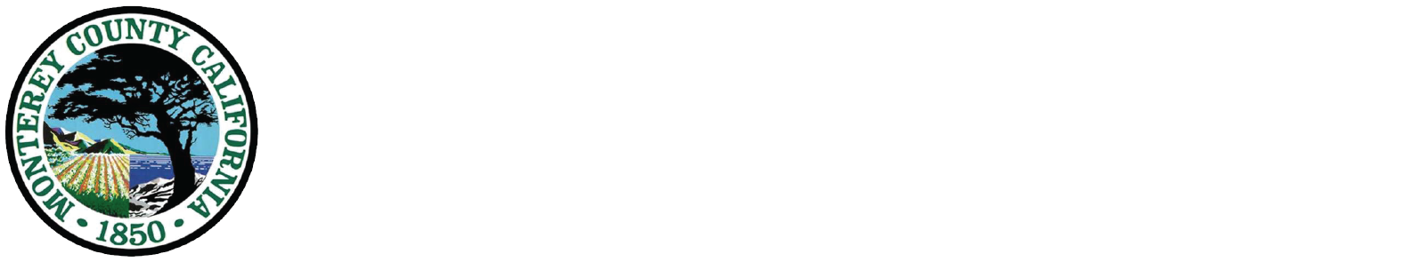

SOCIAL MEDIA
2016 QUARTERLY REPORT
July 1, 2016 – September 30, 2016
Breadth… How many people are connecting with MCHD on our social media channels?
Twitter: Our followers grew 9.39% to 827. On average, tweets reached 1,600 people per day totaling 142,500 impressions
Facebook: The number of Facebook page likes grew from 345 to 438
YouTube: Total number of minutes watched of MCHDPEP videos reached 2,921 during this period
Direct Engagement… What content did people interact with on social media?
Want to work with us? Go tohttps://www.governmentjobs.com/careers/montereycounty
Join us in making a #healthymontereycounty
#soberanesfire pic.twitter.com/upbWVGIPTx
Toro Park will be closed to the public starting tomorrow. Park will be used as base camp for the #soberanfire firefighters
30 Likes/Shares/Comments
reaching 1,382 people
141 Total engagements,
4,924 Impressions
4,100 Impressions, 7 Likes, 15 Retweets, 71 Detail Expands
Depth… Did people click through to our website?
Top
From Social Media sites:
From Mass Media sites:
96
75
Sources of traffic
to mtyhd.org
448 from Facebook
40 from Twitter
96 from cdph.ca.gov
75 from emsa.ca.gov
STAY CONNECTED WITH US!
FACEBOOK facebook.com/mtyhd
TWITTER twitter.com/mchdpio
YOUTUBE youtube.com/mchdpep

Slide 2



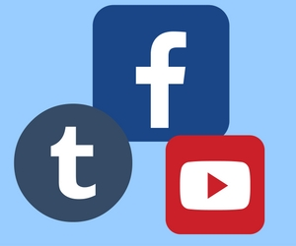
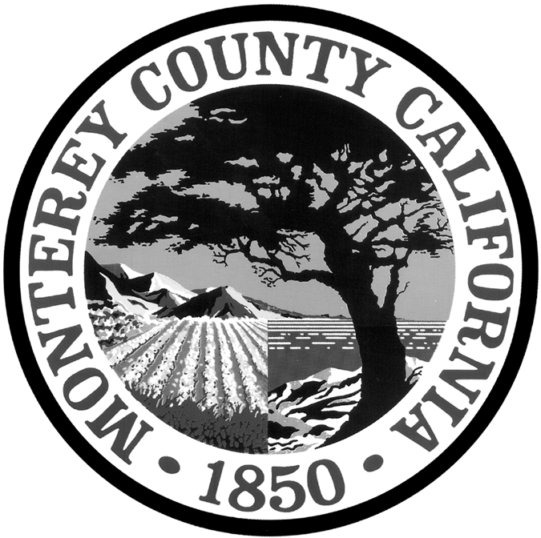
Loyalty… Which social networking sites sent the most repeat visitors to mtyhd.org?
29
181
FROM
FROM
The Buzz… What are people saying about us on social media?
#SoberanesFire - @MCHDPIO I hope that you're actively warning people in Carmel to stay inside due to dangerous air quality this morning
@barriefiske
July 31, 2016
@NACCHOalerts
August 19, 2016
@Intervervention
June 24, 2016
Congrats to @BMore_Healthy @CityMplsHealth @MCHDPIO @HoustonHealth & @MultCoHealth on @CDCInjury award to prevent youth/teen dating violence
@MariLynch @soledadAsstSup @JodiMassa @MCHDPIO PM coming time soon! Stay tuned! AM works as we catch parents during drop off 👏
Campaigns… How did our coordinated social media projects perform?
Disaster Preparedness and Response: Social media is a critical part of disaster response. During the Soberanes Fire, Twitter and Facebook were used to get up-to-date information about the fire and its impact on health to concerned residents. The platforms were also used to get feedback from residents regarding health and safety concerns. This feedback was helpful for creating more messages. September was Preparedness Month providing an opportunity to post daily preparedness tips.
Strategic Outcomes… How did our social media communication affect our organization?
This quarter social media was key to communicating about the Soberanes Fire.
During September, daily preparedness tips reinforced messages about resiliency.
This quarter we ocused on messages Monterey County residents can act on to improve not only their preparedness but also the resiliency of their community.
We better serve Monterey County residents and maintain our relevance, by providing them information on commonly used social media platforms
QUESTIONS? COMMENTS? MORE INFORMATION?
Contact Public Information Officer Karen Smith for more information klahnk@co.monterey.ca.us
Template design by Sarah Kaczmarek, GAO
http://sarahkaczmarek.com/portfolio/

