Slide 1
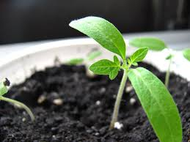
Part 3: Composting
Please remember to use arrows to navigate.

Slide 2
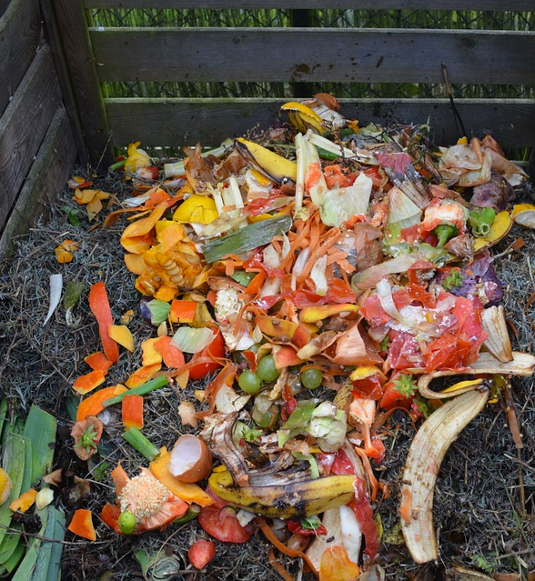
The next slides will cover:
Composting to divert organic waste
What compost is
How composting works
Examples of compostable waste
Benefits of composting
How to compost at home

Slide 3
Food in Landfills make bad things
Food waste in landfills combine with water and other trash to create a toxic liquid called leachate.
If Leachate goes into the environment, it can harm animals and our rivers and drinking water.
Food waste in landfills produce a gas called methane.
Methane is a greenhouse gas. Greenhouse gases causes climate change.

Slide 4
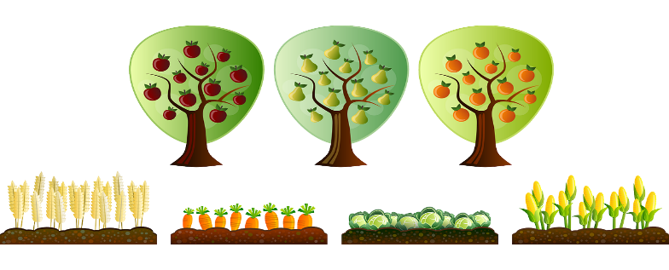
Composting stops food and organic material from going into Landfills
When less food and organics go into the Landfill, less methane and leachate are created.

Slide 5
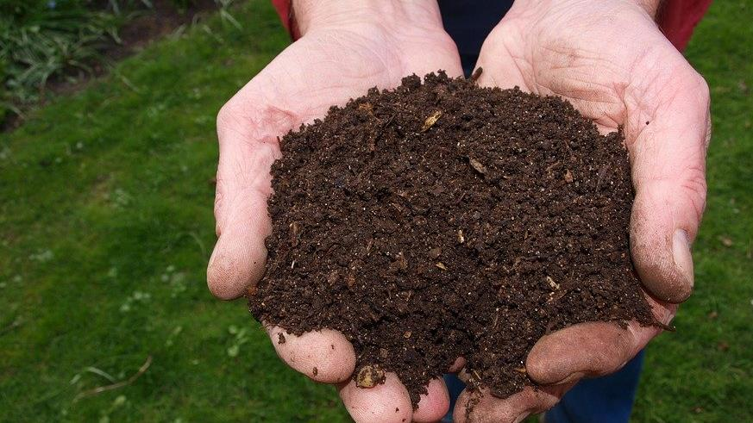
This is Compost
Composting is making compost from yard waste and food waste
Compost can also be used as a verb and it means to make into compost
Compost is also called Humus
Compost has lots of nutrients and can mixed with the soil to feed plants.

Slide 6
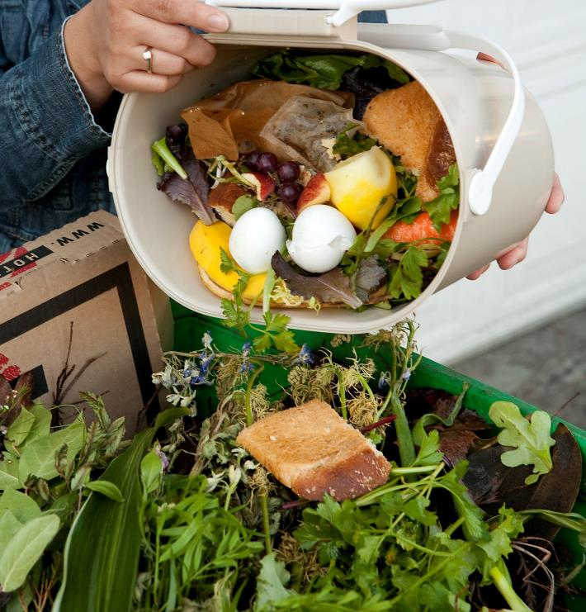
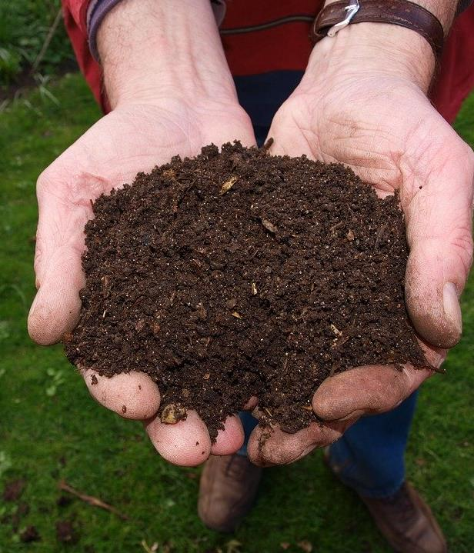
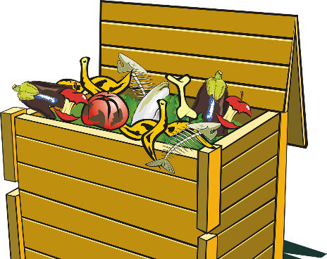
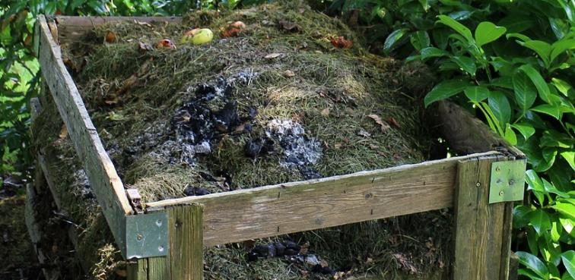
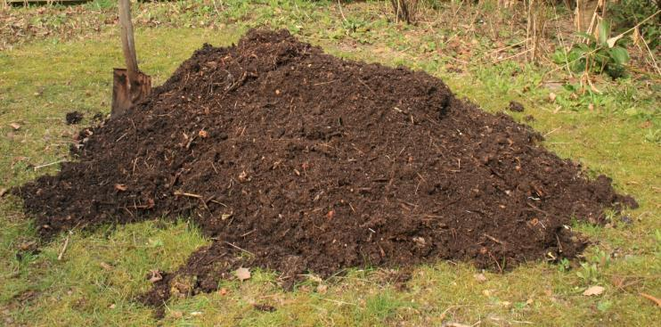
1
This is how compost works!
Yard waste like fallen leaves, twigs, and grass are mixed with food waste in a pile and billions of tiny creatures that live in the pile eats and eats.
The more those tiny creatures eat, the smaller the pile becomes. The pile slowly turns into compost which looks just like soil.
5
2
3
4

Slide 7
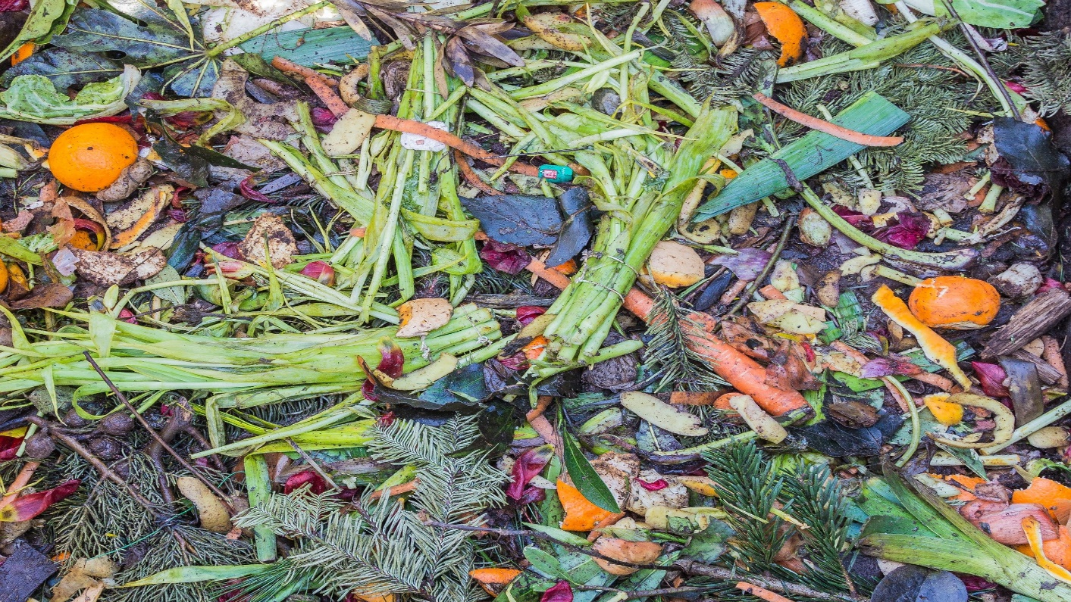
WHAT CAN BE COMPOSTED?
Food waste
Fruit & vegetable trimmings
Coffee grounds
Eggshells
Bread and grains
Leaves
Pine needles
Lawn clippings
Twigs and branches
Plastic
Milk cartons
Metal cans
Paper plates
Stickers on fruits & vegetables
Glass jars

Slide 8
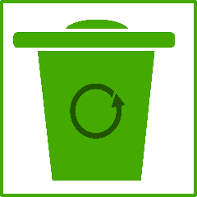
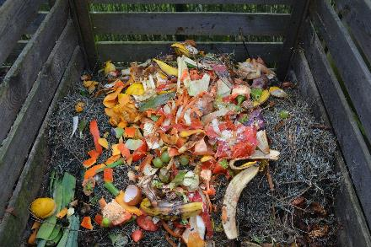
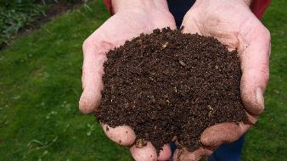
Closed Food Cycle
Food and Organics
In the compost Bin, tiny creatures break down food scraps and organic matter.
Food scraps go into compost Bin
This soil can be used to grow more food by using it in home gardens or to plant crops.
Compost turns to humus which looks like dark soil.

Slide 9
Composting is good for People and good for the Environment
Composting the food we don’t eat is not wasting it. It helps make new compost that can feed the plants to make fruits and vegetables we eat.
That’s how the food cycle works and how we can help the plants grow.
Did you know all other plants like trees and flowers need compost too?

Slide 10
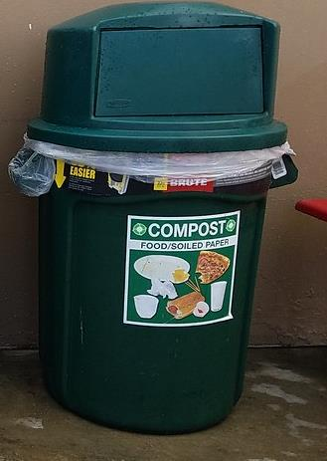
These Are Compost Bins
When you put food you don’t eat in the compost bins, it can be used to make new compost.

Slide 11
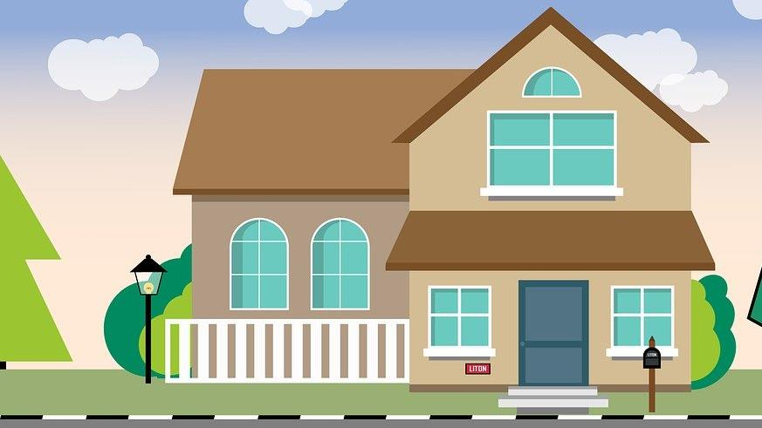
You Can Start Composting At Home or Apartment
Ask your parents or teacher for help.
There are lots of great videos and instructions on how to compost on the internet.
The compost pile can be small or big and you can choose.
Good Luck!

Slide 12
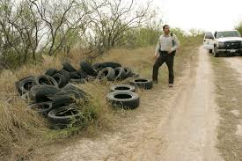
Part 3 has been Completed.
Please Move on to Part 4: Illegal Dumping & Litter

