Slide 1
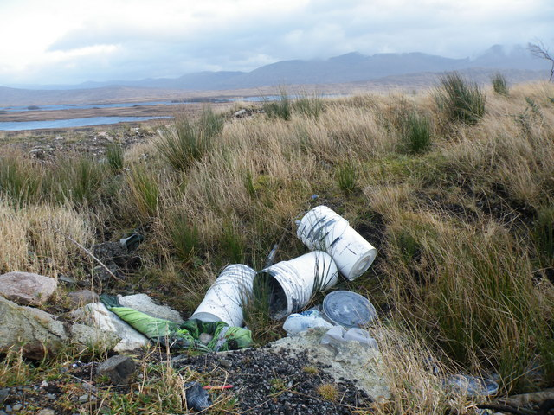
Part 4:Littering and
Illegal Dumping
Monterey County Health Department

Slide 2
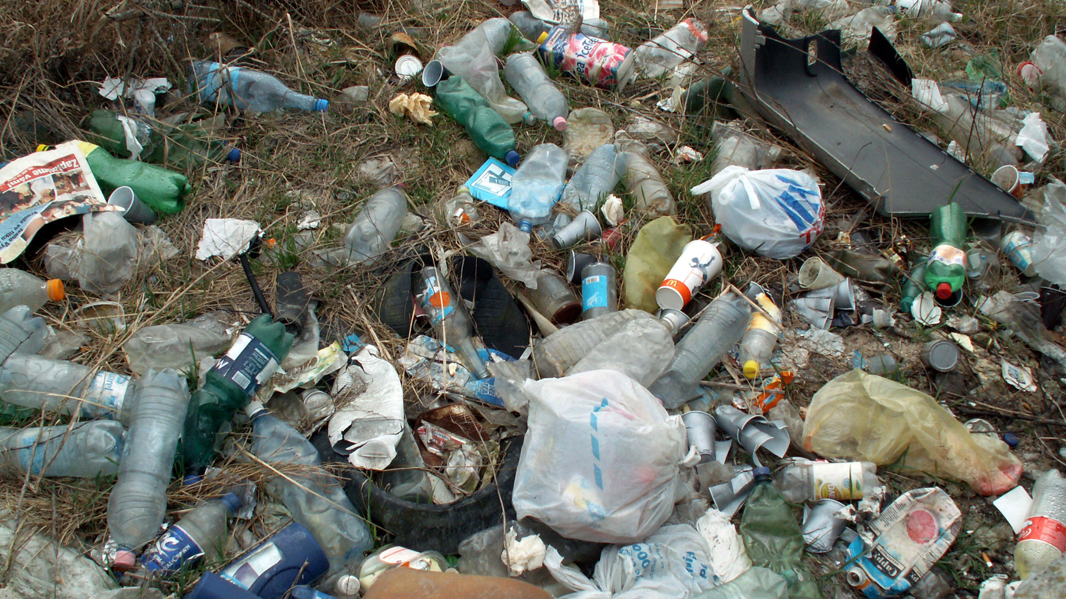
The next slides will cover:
What littering is
What illegal dumping is
Why we should not litter or illegal dump trash

Slide 3
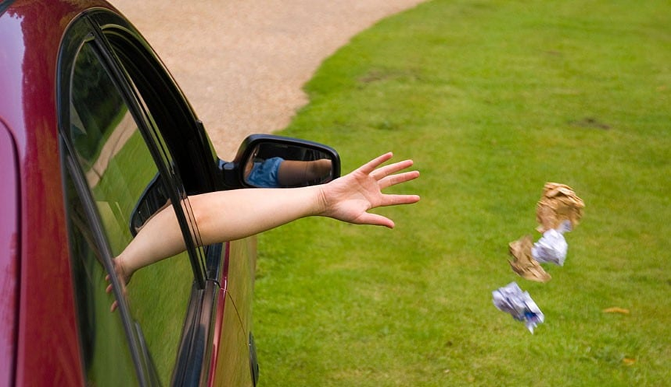
What is littering?
Litter is any kind of trash thrown in small amounts, especially in places where it doesn’t belong.

Slide 4
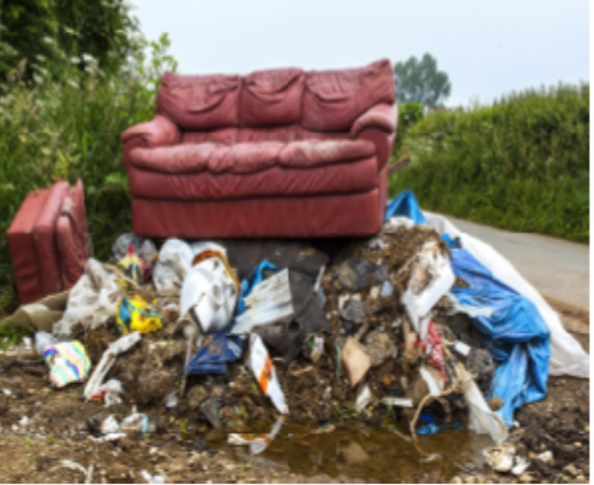
What is Illegal Dumping?
Illegal dumping is the disposal of solid waste at a site other than a permitted disposal facility, such as a landfill.
Illegal dumping is illegal and is a crime.

Slide 5
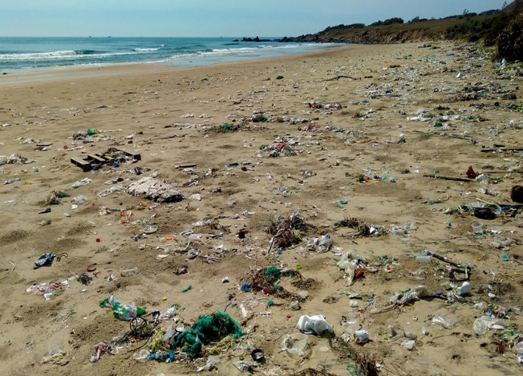
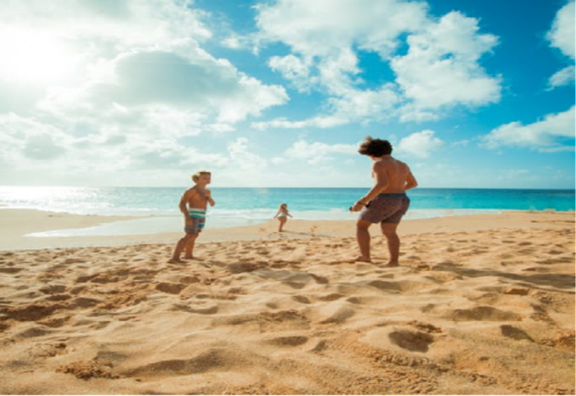
Where would you like to play?
or

Slide 6
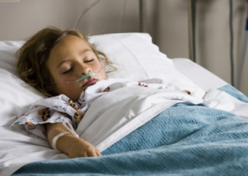
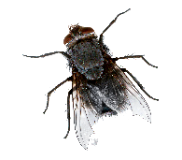
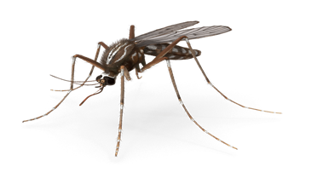

What can happen to us if we litter or illegally dump trash?
It is a possible fire hazard, and may contain dangerous hazardous materials and chemicals.
It is contaminating our environment, our water sources, and our crops.
It threatens human health and safety by attracting and harboring disease-transmitting mosquitoes, rats, and flies.
Illegal Dumping is a serious offense and is in violation which can lead to fines and legal action.

Slide 7
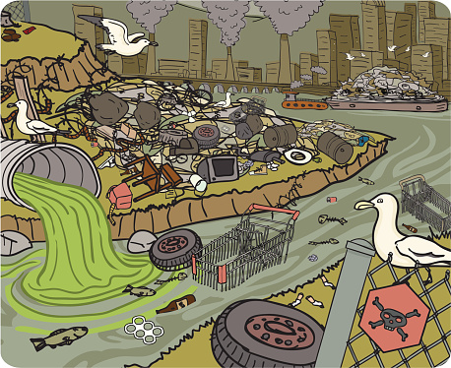
What can happen to our environment if we litter or illegally dump trash?
Air pollution.
Water pollution.
Soil pollution.
Hurting animals, fish and birds.

Slide 8


Ways to Help
Speak to your teacher or an adult at home if you see illegal dumping.
Volunteer to help in community cleaning events.
(With your parents or guardian permission.)
Learn and practice: Reduce, Reuse and Recycle.
Do not litter and keep your class, home, road and community clean and healthy.

Slide 9

Part 4 Has Been Completed.
Please Move on to Part 5: Test.

