Slide 1
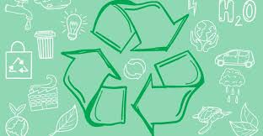
Part 2: Recycling
Please remember to use your arrows to navigate.

Slide 2
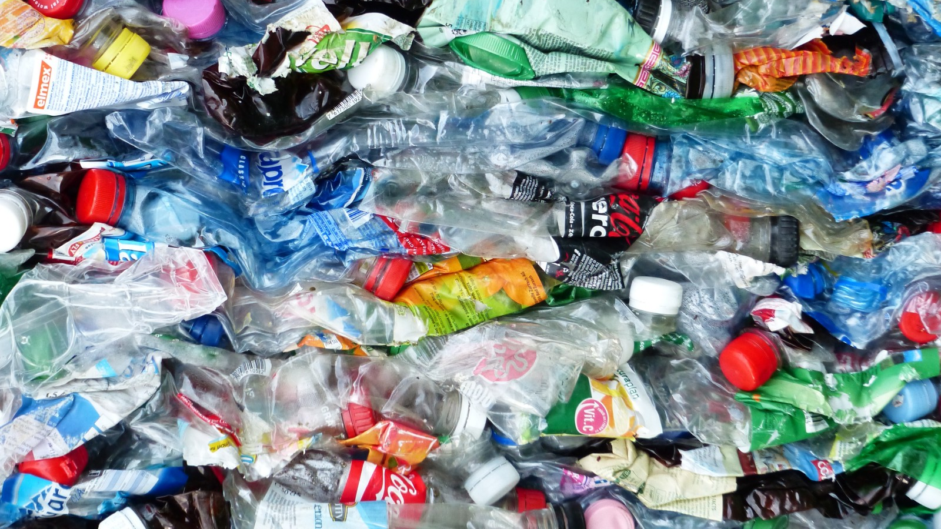
The next slides will cover:
Recycling and its importance
Examples of recyclable waste
Where recyclables go after collection
Recycling cycles of paper, aluminum cans, plastic, and glass

Slide 3
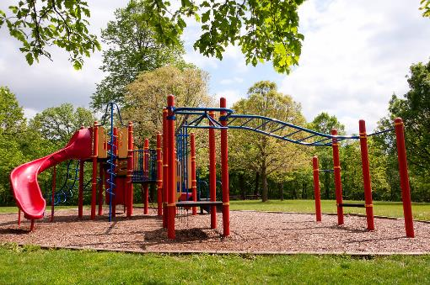
Recycling stops recyclable material from going into landfills, nature, and our neighborhoods.
When less recyclable materials don’t go to the landfill, there is more space for garbage and trash.
When less recyclable materials go into our parks, rivers, and oceans, it is safer and cleaner place to spend the day for everyone and every animal.

Slide 4
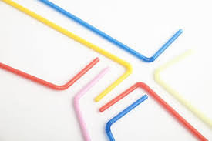
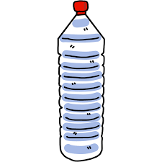
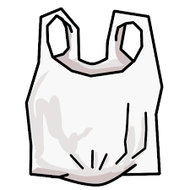
Plastic Straws can take to 200 years to break down.
Aluminum Cans can take 200 years to break down.
Plastic Bags can take to 10 –20 years to break down.
Plastic Bottles can take 450 years to break down.
When the recyclable items like plastic and aluminum go out into nature like our rivers, oceans, and forest, it will stay there for a long time.

Slide 5
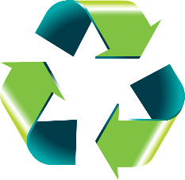
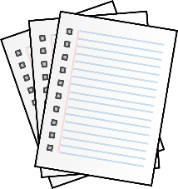
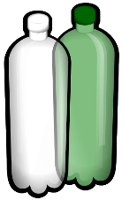
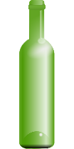
When we put our recyclable material in the recycling bin, we can make all of these things from your used recyclable materials.
New Paper
New Milk Carton
New Cardboard
New Plastic Bottles
New Glass Jars
And Bottles
New Aluminum Cans

Slide 6
WHAT CAN BE RECYCLED?
Plastic Bottles and Containers
Milk Cartons
Metal Cans
Paper and paper plates
Glass Jars and Bottles
Cardboard
Food Waste
Fruit & Vegetable trimmings
Coffee Grounds
Eggshells
Bread and grains
Leaves
Pine needles
Lawn Clippings
Twigs and branches

Slide 7
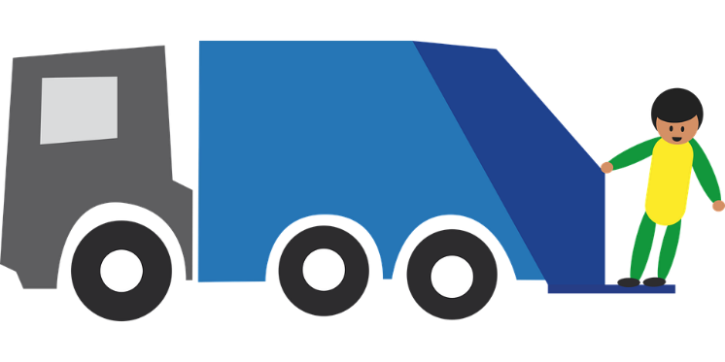
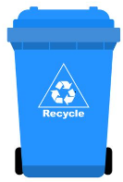
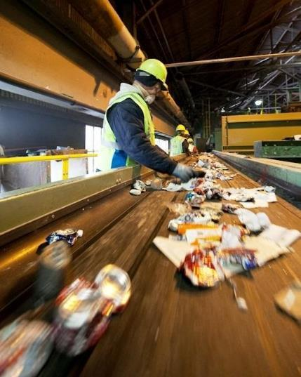
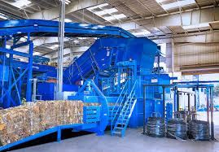
Our garbage companies use recycling trucks that look like garbage trucks to only pick up our recyclables.
Recycling Facilities are where recyclables go to separate paper, plastic, and cardboard into large bundles called bales. Glass is also separated.
A Recycling facility is also called a Material Recovery facility (MRF).

Slide 8
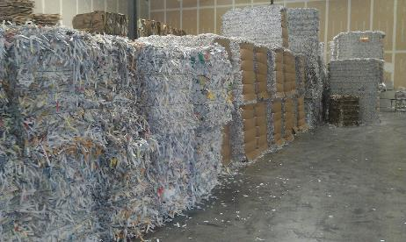
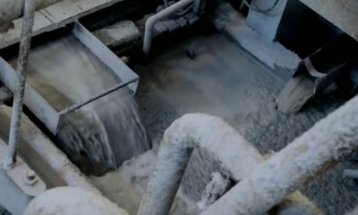
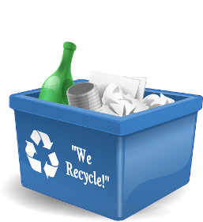
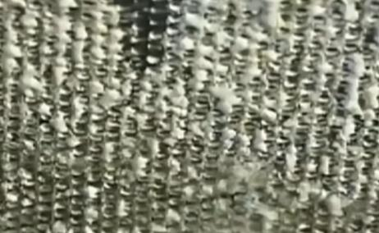
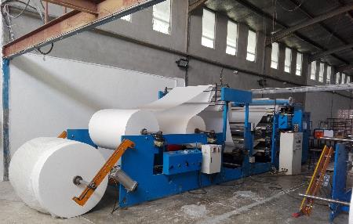
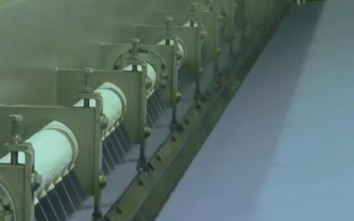
Recycled paper from our recycle bin goes to the recycling facility to be separated from other material into large bundles called bales.
Paper Recycling Cycle
Paper is broken down into smaller pieces and fibers called pulp using a large machine with water, chemicals, and heat. The ink is removed
Large bales of papers go to the paper mill to be separated by types of paper.
The pulp goes on a flat object called a conveyor belt and sprayed with water to make the fibers and small pieces stick together.
Heated metal rollers will dry out the pulp to make paper. The paper is rolled up.
The fibers go through a screen to remove contaminants and sticky adhesive.
New paper is made.

Slide 9
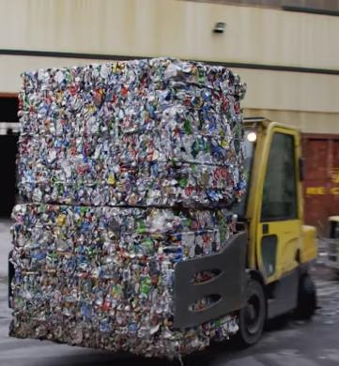
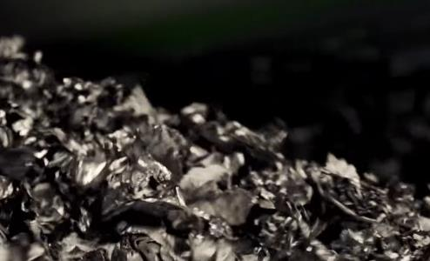
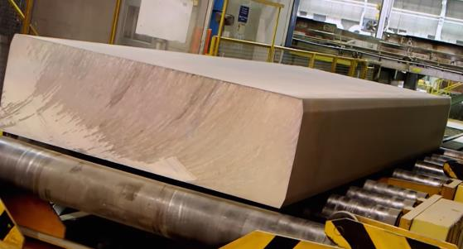
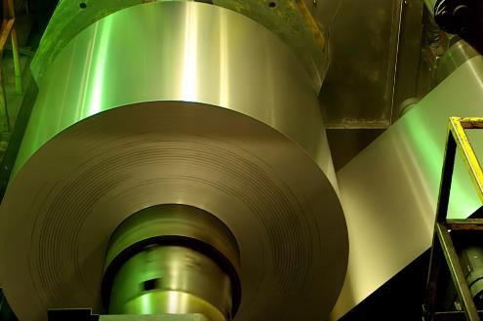
Aluminum Can Recycling Cycle
Recycled Aluminum goes to the recycling facility to be separated from other and stored into bales.
Each aluminum cans are shredded, and plastic are removed. The cans are heated to removed painter and lacquer.
Bales of aluminum cans go to Aluminum recycling facility.
New facility. The blocks are heated and thins out the metal and roll it up into sheets.
The aluminum rolls go to are made into can
Aluminum chips are melted into large aluminum blocks.

Slide 10
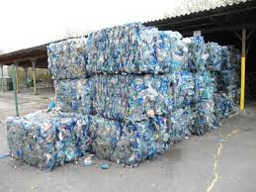
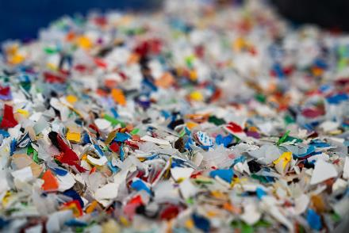
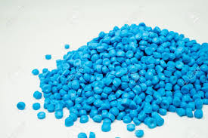
Plastic Recycling Cycle
Recycled plastic bottles and containers goes to the recycling facility to be separated from other material and stored into bales.
Bales of plastic bottles go to plastic recycling facility.
Plastic bottles are separated, washed, and labels are removed. Plastic bottles shredded into small plastic pieces.
Plastic pieces are melted into plastic pellets.
Plastic pellets sent to plastic manufacturer to be made into new plastic bottles and containers.
Plastic pellets are mixed with other material to make toys, clothes, and other plastic items. They mix These items can’t be recycled.

Slide 11
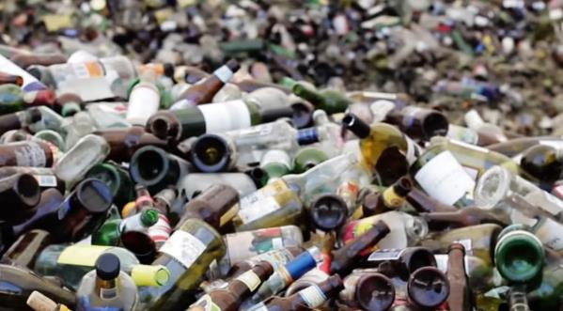
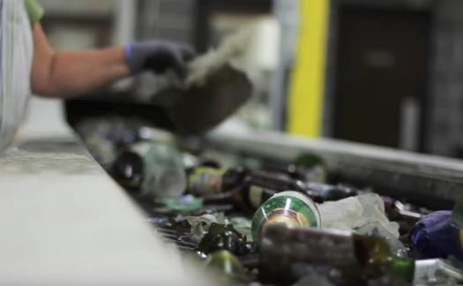
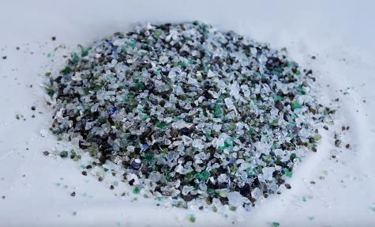
Glass Recycling Cycle
Glass bottles are cleaned and the labels on the containers are removed
Recycled glass bottles and jars goes to the recycling facility to be separated from other material.
Glass bottles and jars go to glass recycling facility and are placed on the conveyor belt to be processed.
Glass bottles are crushed into small pieces called cullets and separated by colors (green, brown, clear).
Cullets are mixed with other ingredients and melted. The melted glass is molded into new glass bottles and jars.

Slide 12
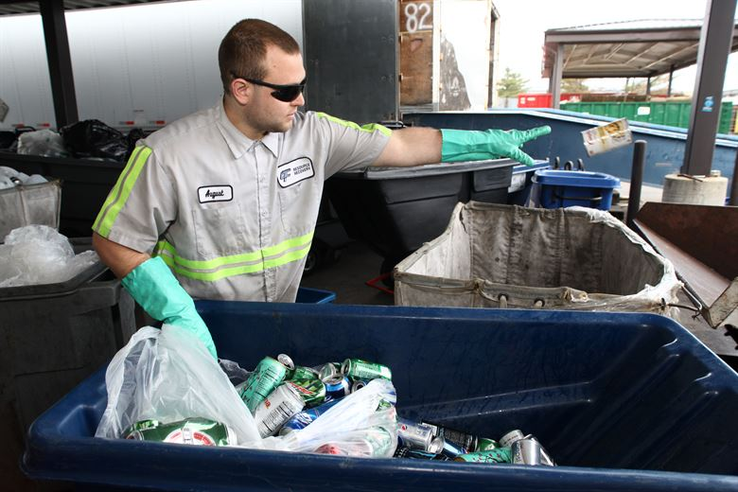
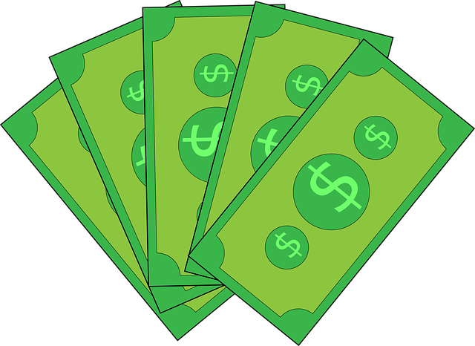
Recycle For Cash
You can also collect your own recyclables such as aluminum cans, plastic bottles and you take them to a recycling take-back facility to redeem for some cash.

Slide 13
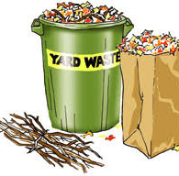
Part 2 has been Completed.
Please Exit and Move on to Part 3: Composting

