Slide 1
Diverting Our Waste
Presented by Monterey County Environmental Health Bureau

Slide 2
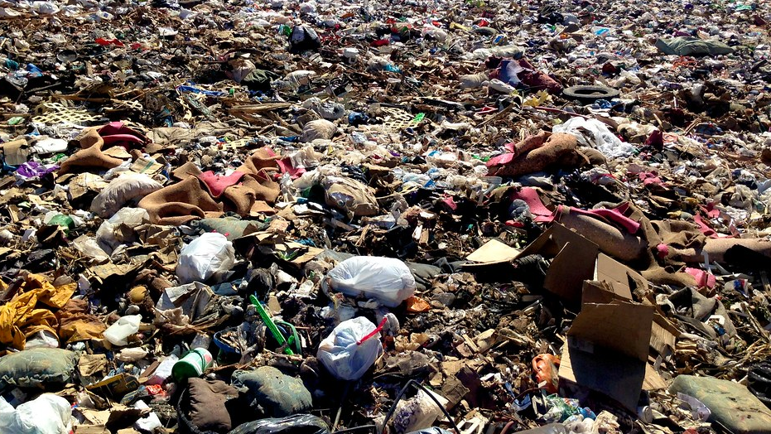
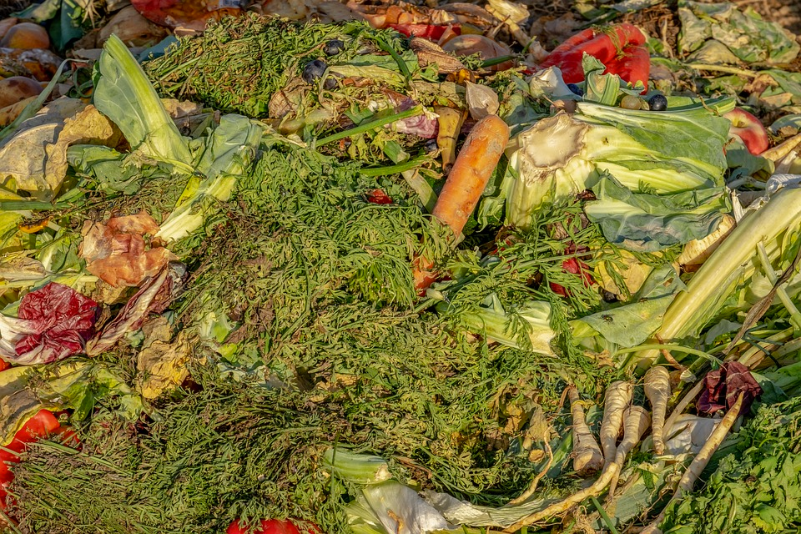
This Power Point is a 5-part Series:
Solid Waste
Types of waste and where they go
What a landfill is
Recycling
Processing recyclables after collection
Composting
Why it's important to compost
Illegal Dumping & Litter
Test
Please use arrows to navigate through the power point.

Slide 3
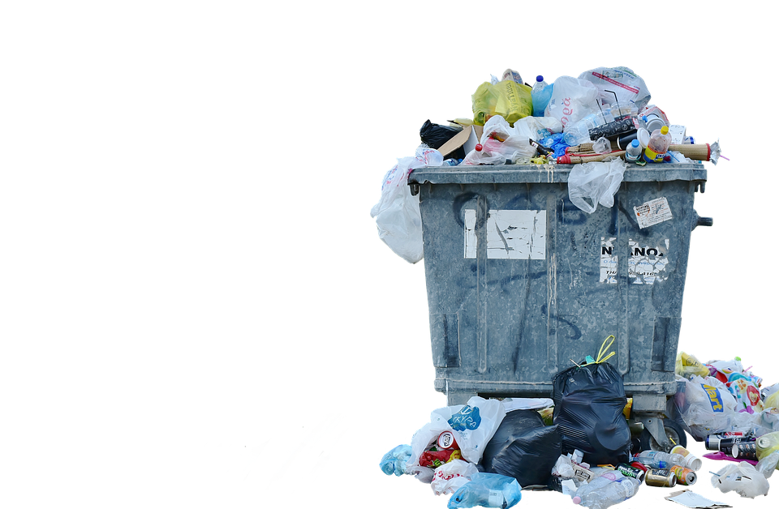
Part 1: Solid Waste

Slide 4
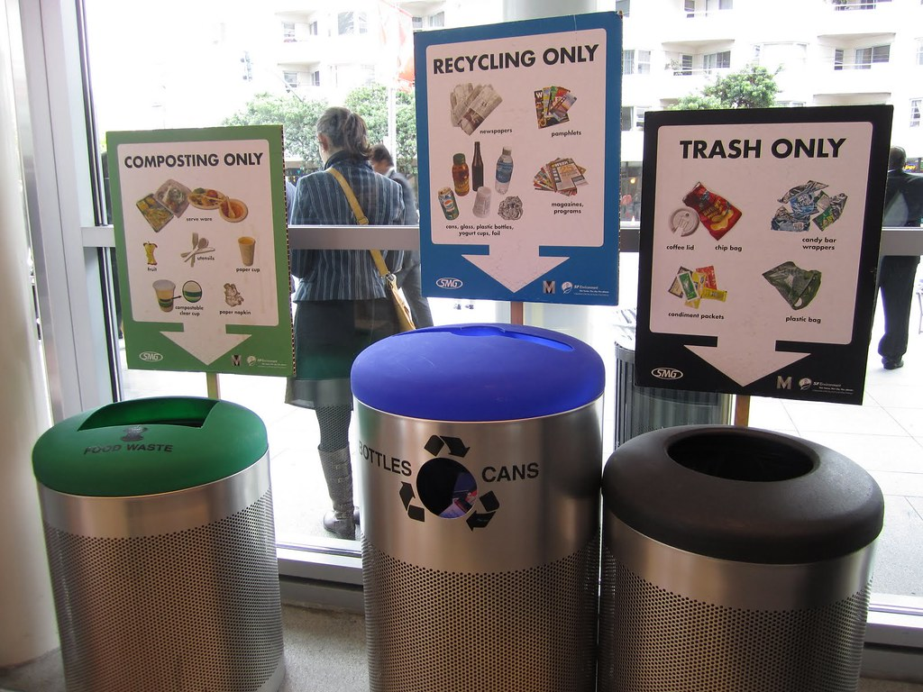
The next slides will cover:
What waste is
Types of waste
Where each type of waste goes
What a landfill is
How a landfill works
Issues with landfills

Slide 5
These are the steps to stop making more waste.
1. Reducing
the amount of waste produced.
2. Reusing
materials repeatedly like reusable water bottles.
3. Recycling
materials to make new products.
4. Composting
food scraps or yard waste to make compost.
5. Disposing
garbage and trash at the landfill.

Slide 6
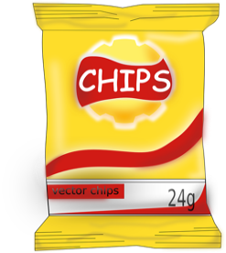
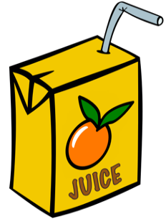
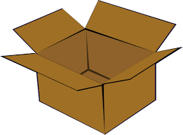
We all generate waste everyday
Waste is material we can’t use anymore so it gets thrown away
Lots of things in our lives become some kind of waste after we use it, like:
Takeout containers from restaurants
Candy wrappers
Empty chip bag
Empty juice box
Packaging for toys
Used paper towels

Slide 7
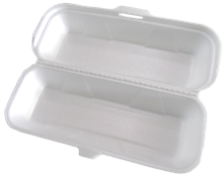
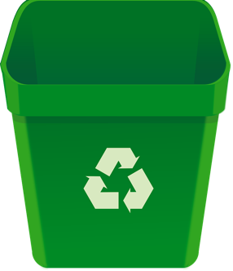
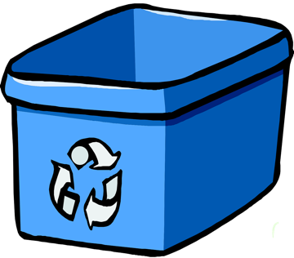
4 Types of Waste
Garbage is any waste that is not yard waste, recyclable, or compostable
Yard waste is leaves, branches, and plant trimmings
Recycling is for waste that can be changed into other materials
Food waste is uneaten food or inedible scraps from food preparation
Yard Waste
Compost
Garbage bin
Yard waste bin
Recycling bin
Compost bin
This type of bin can be found at your school!

Slide 8
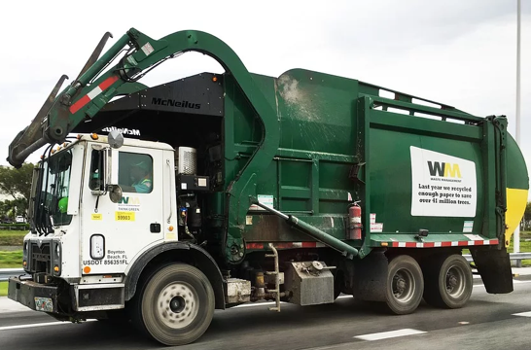
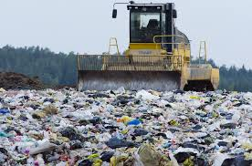
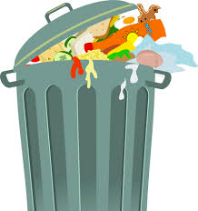
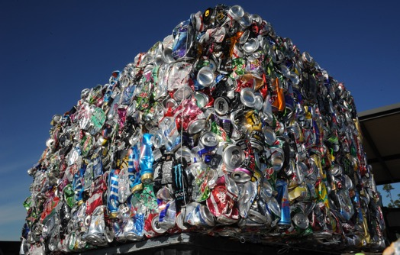
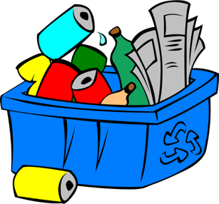
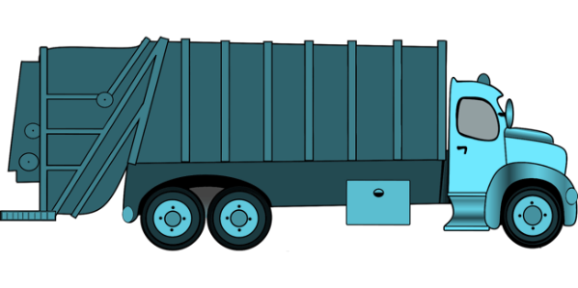
Where does each kind of waste go?
1
2
3
Garbage bin
Garbage truck
Landfill
1
2
3
Recycling bin
Recycling truck
Recycling facility

Slide 9
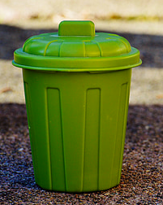
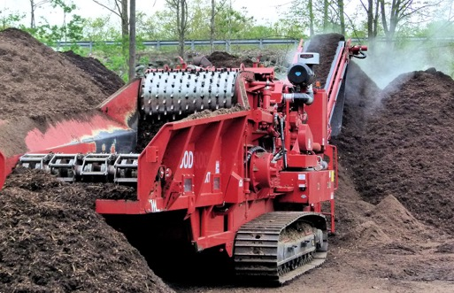
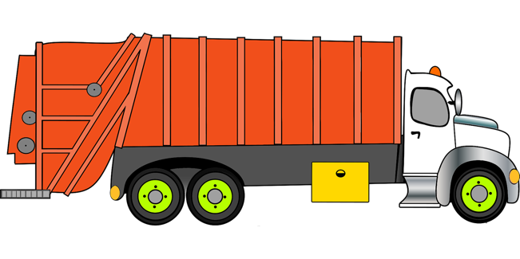
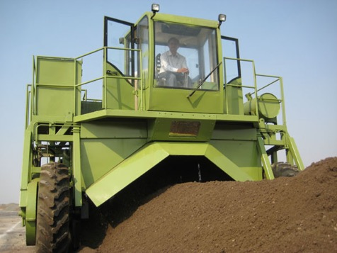
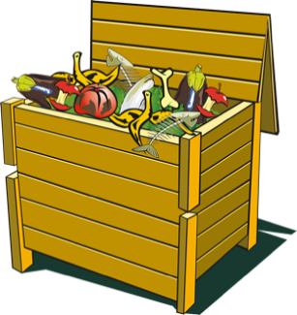
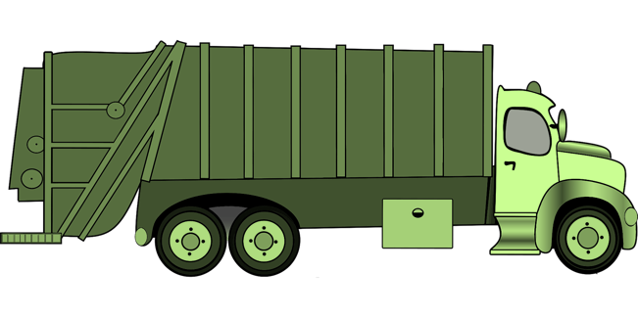
Where does each kind of waste go?
1
2
3
Yard waste bin
Yard waste truck
Chipping & grinding center
1
2
3
4
Compost bin
Compost waste truck
Composting facility

Slide 10
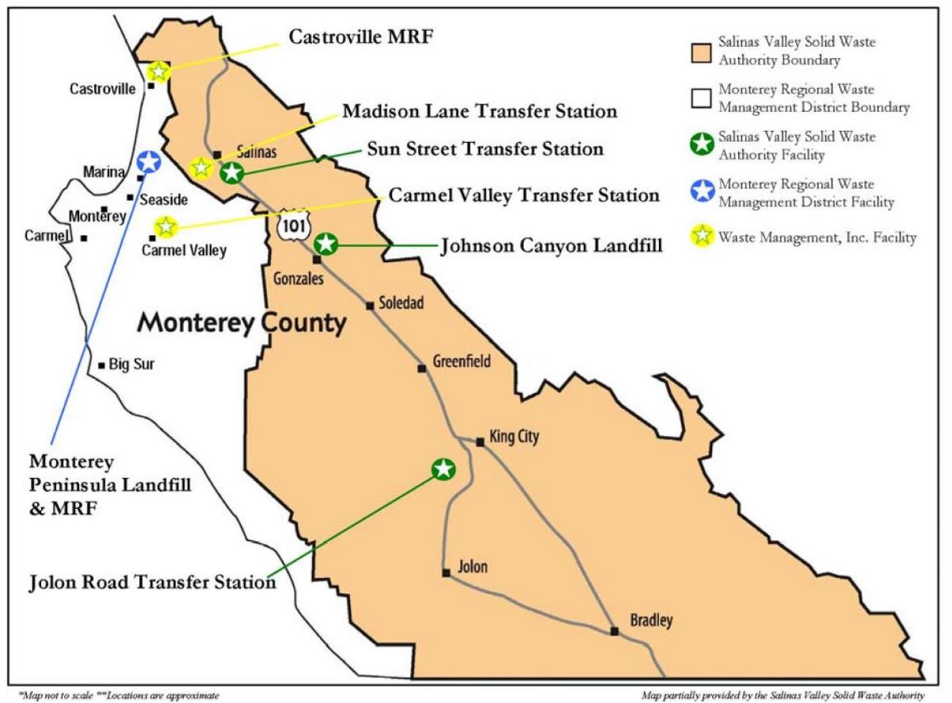
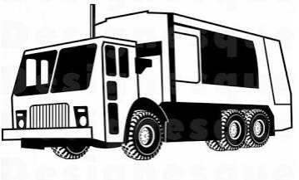
This is a Map of all the places where Garbage, Recyclables, Yard Waste, and Food Waste go in Monterey County

Slide 11
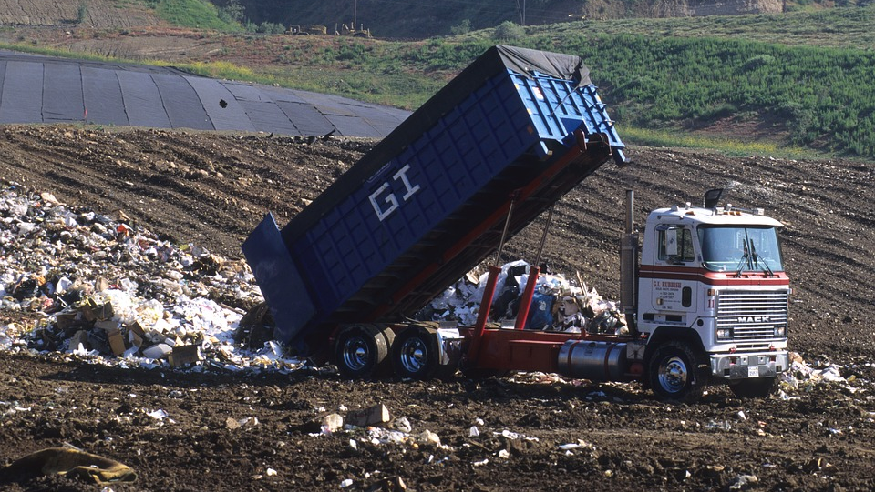
The next slides will cover:
What a landfill is
How a landfill works
Issues with landfills

Slide 12
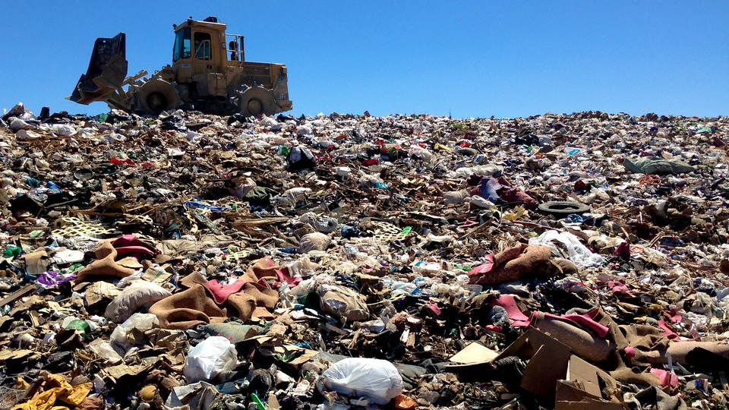
This is a Landfill
A Landfill is a place where our trash and garbage go to be buried and covered to protect people from piles of rotting smelly trash.

Slide 13
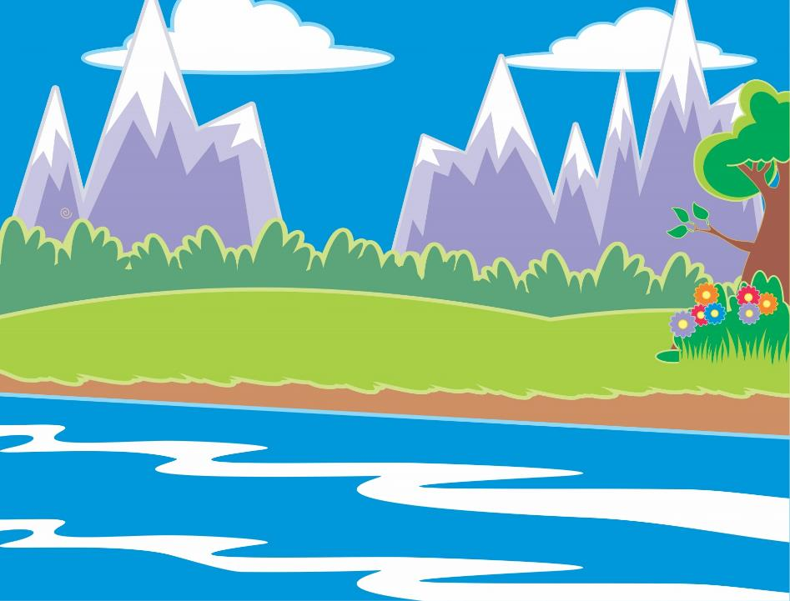
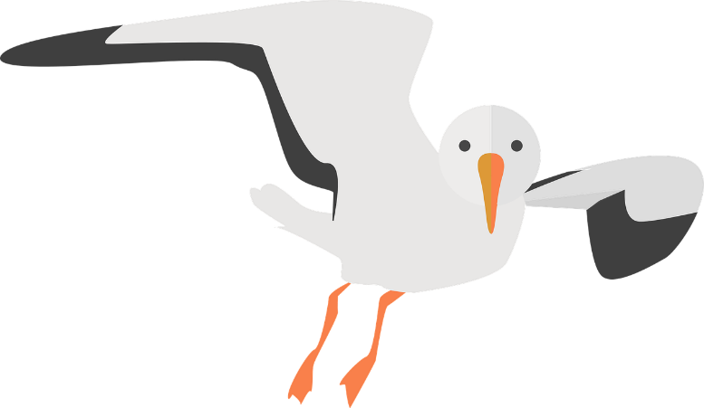
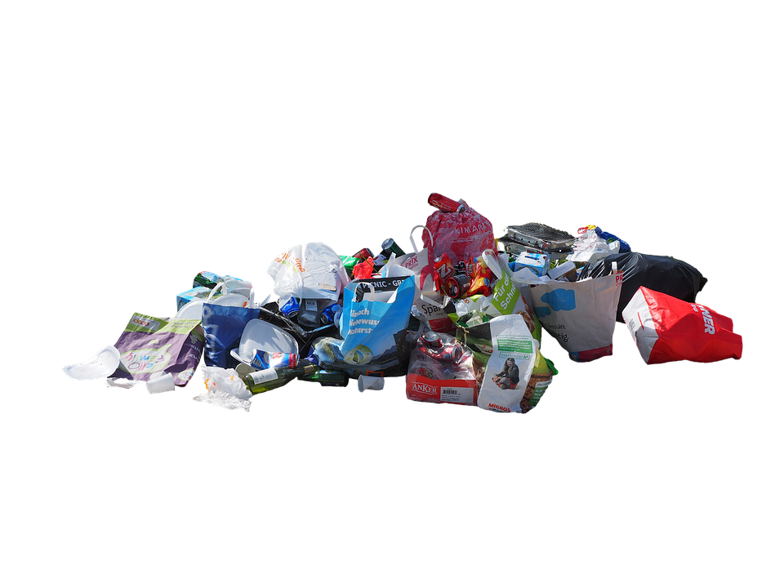
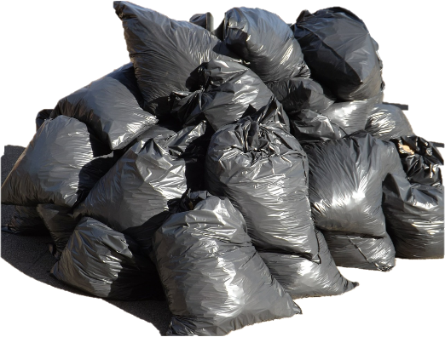
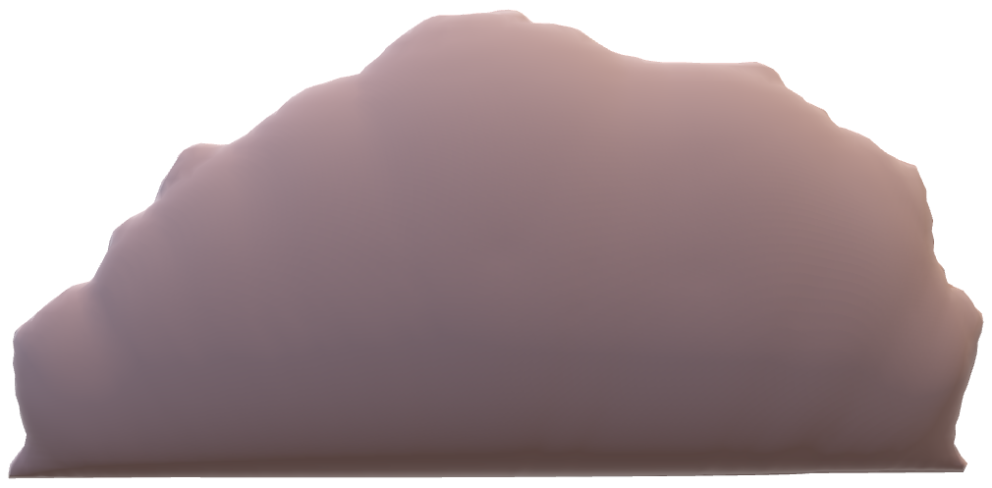
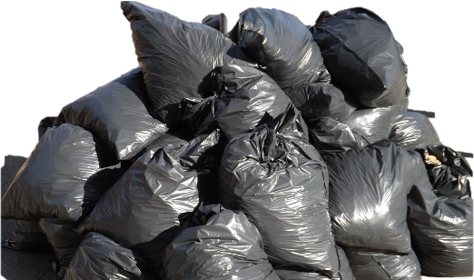
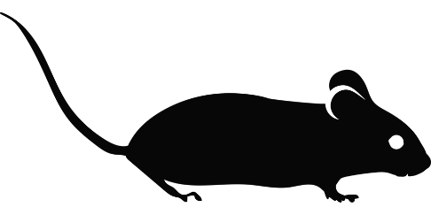
Landfills stops rats, bugs, other animals, and birds from scavenging and living in the smelly trash. These animals and bugs can make people sick if they bite us.
I am so happy the water is clean! :D!
Landfills stop garbage from making the air smelly.
It also keeps garbage from oozing wet stinky dirty water into our rivers, oceans, and water supply.

Slide 14
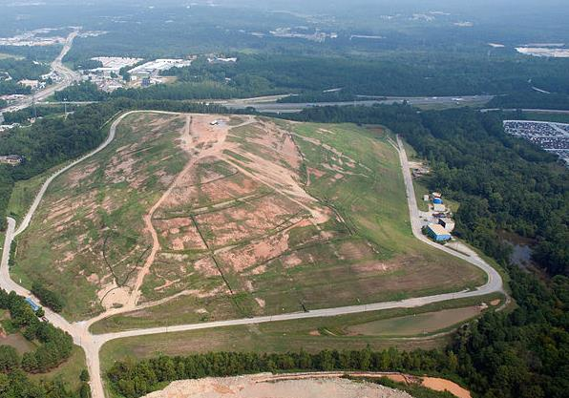
Every Landfill takes up a lot of space.
It is hard to make a new landfill because professionals must find a new big place to build it on and this process takes a long time to design.
This is what a Landfill looks like when it is full, and all the garbage is covered.

Slide 15
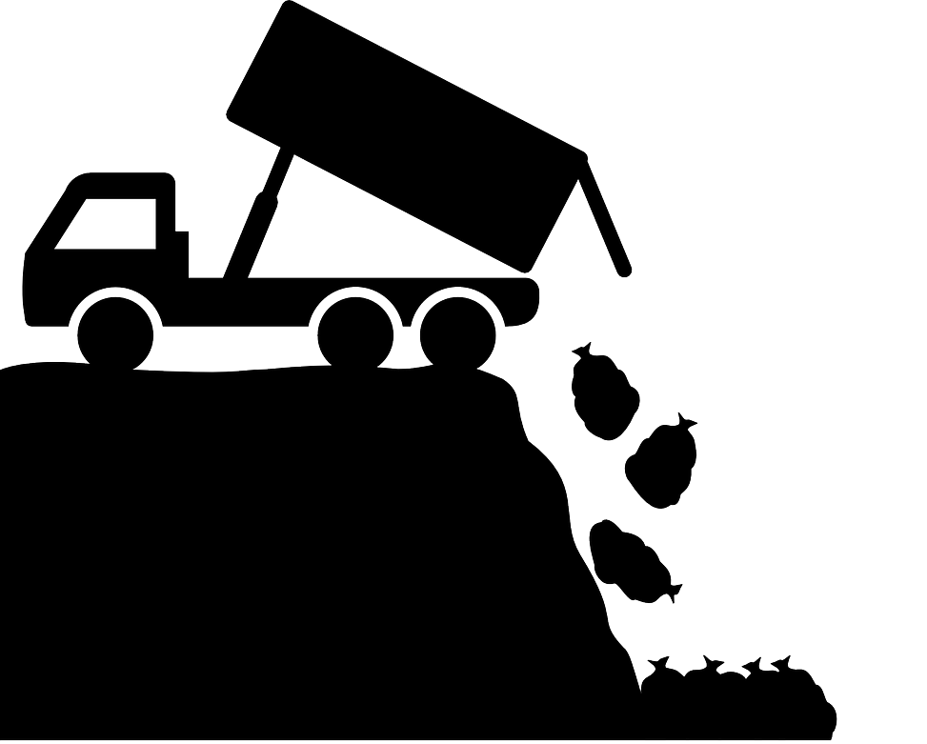
Garbage and trash pile up more and more in the Landfill until it becomes full.
When the Landfill is full, Garbage and Trash can no longer go there to be buried.
Using reusable material, Recycling and composting helps reduce the amount of garbage that go to the landfill, so it takes longer to fill the landfill.

Slide 16
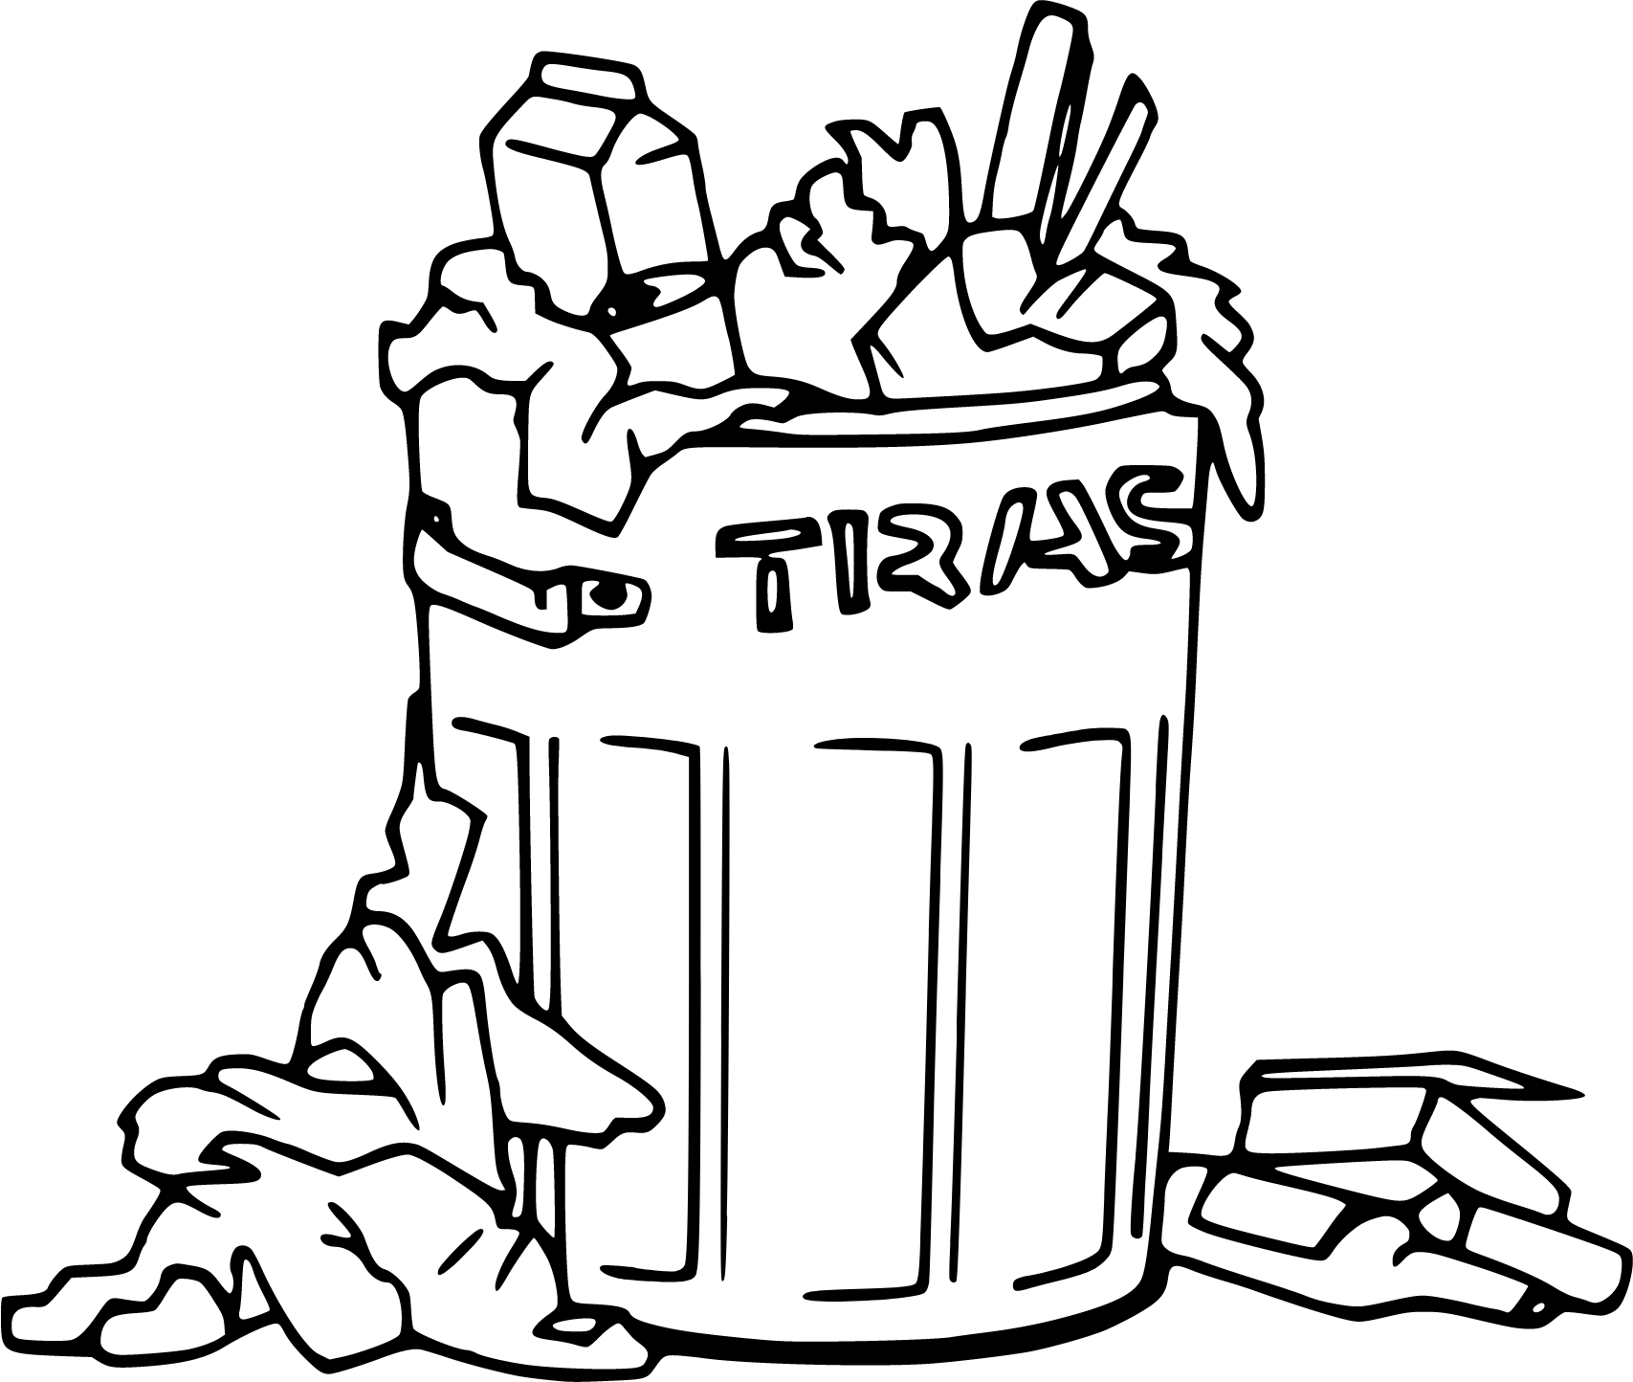
Part 1 has been completed.
Please Exit and Move on to Part 2 Recycling.

